Slide 1


WKU English Department 2020 Award and Scholarship Winners

Slide 2
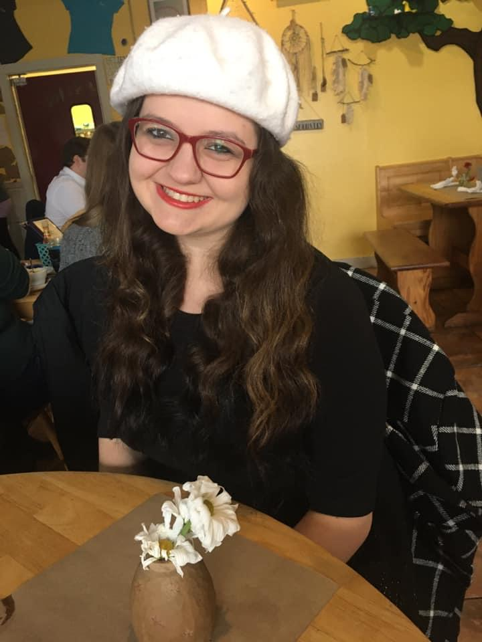
Adrianna Waters
Jim Wayne Miller Scholarship Fund
3rd place in Annual Conference on Literature, Language and Culture

Slide 3
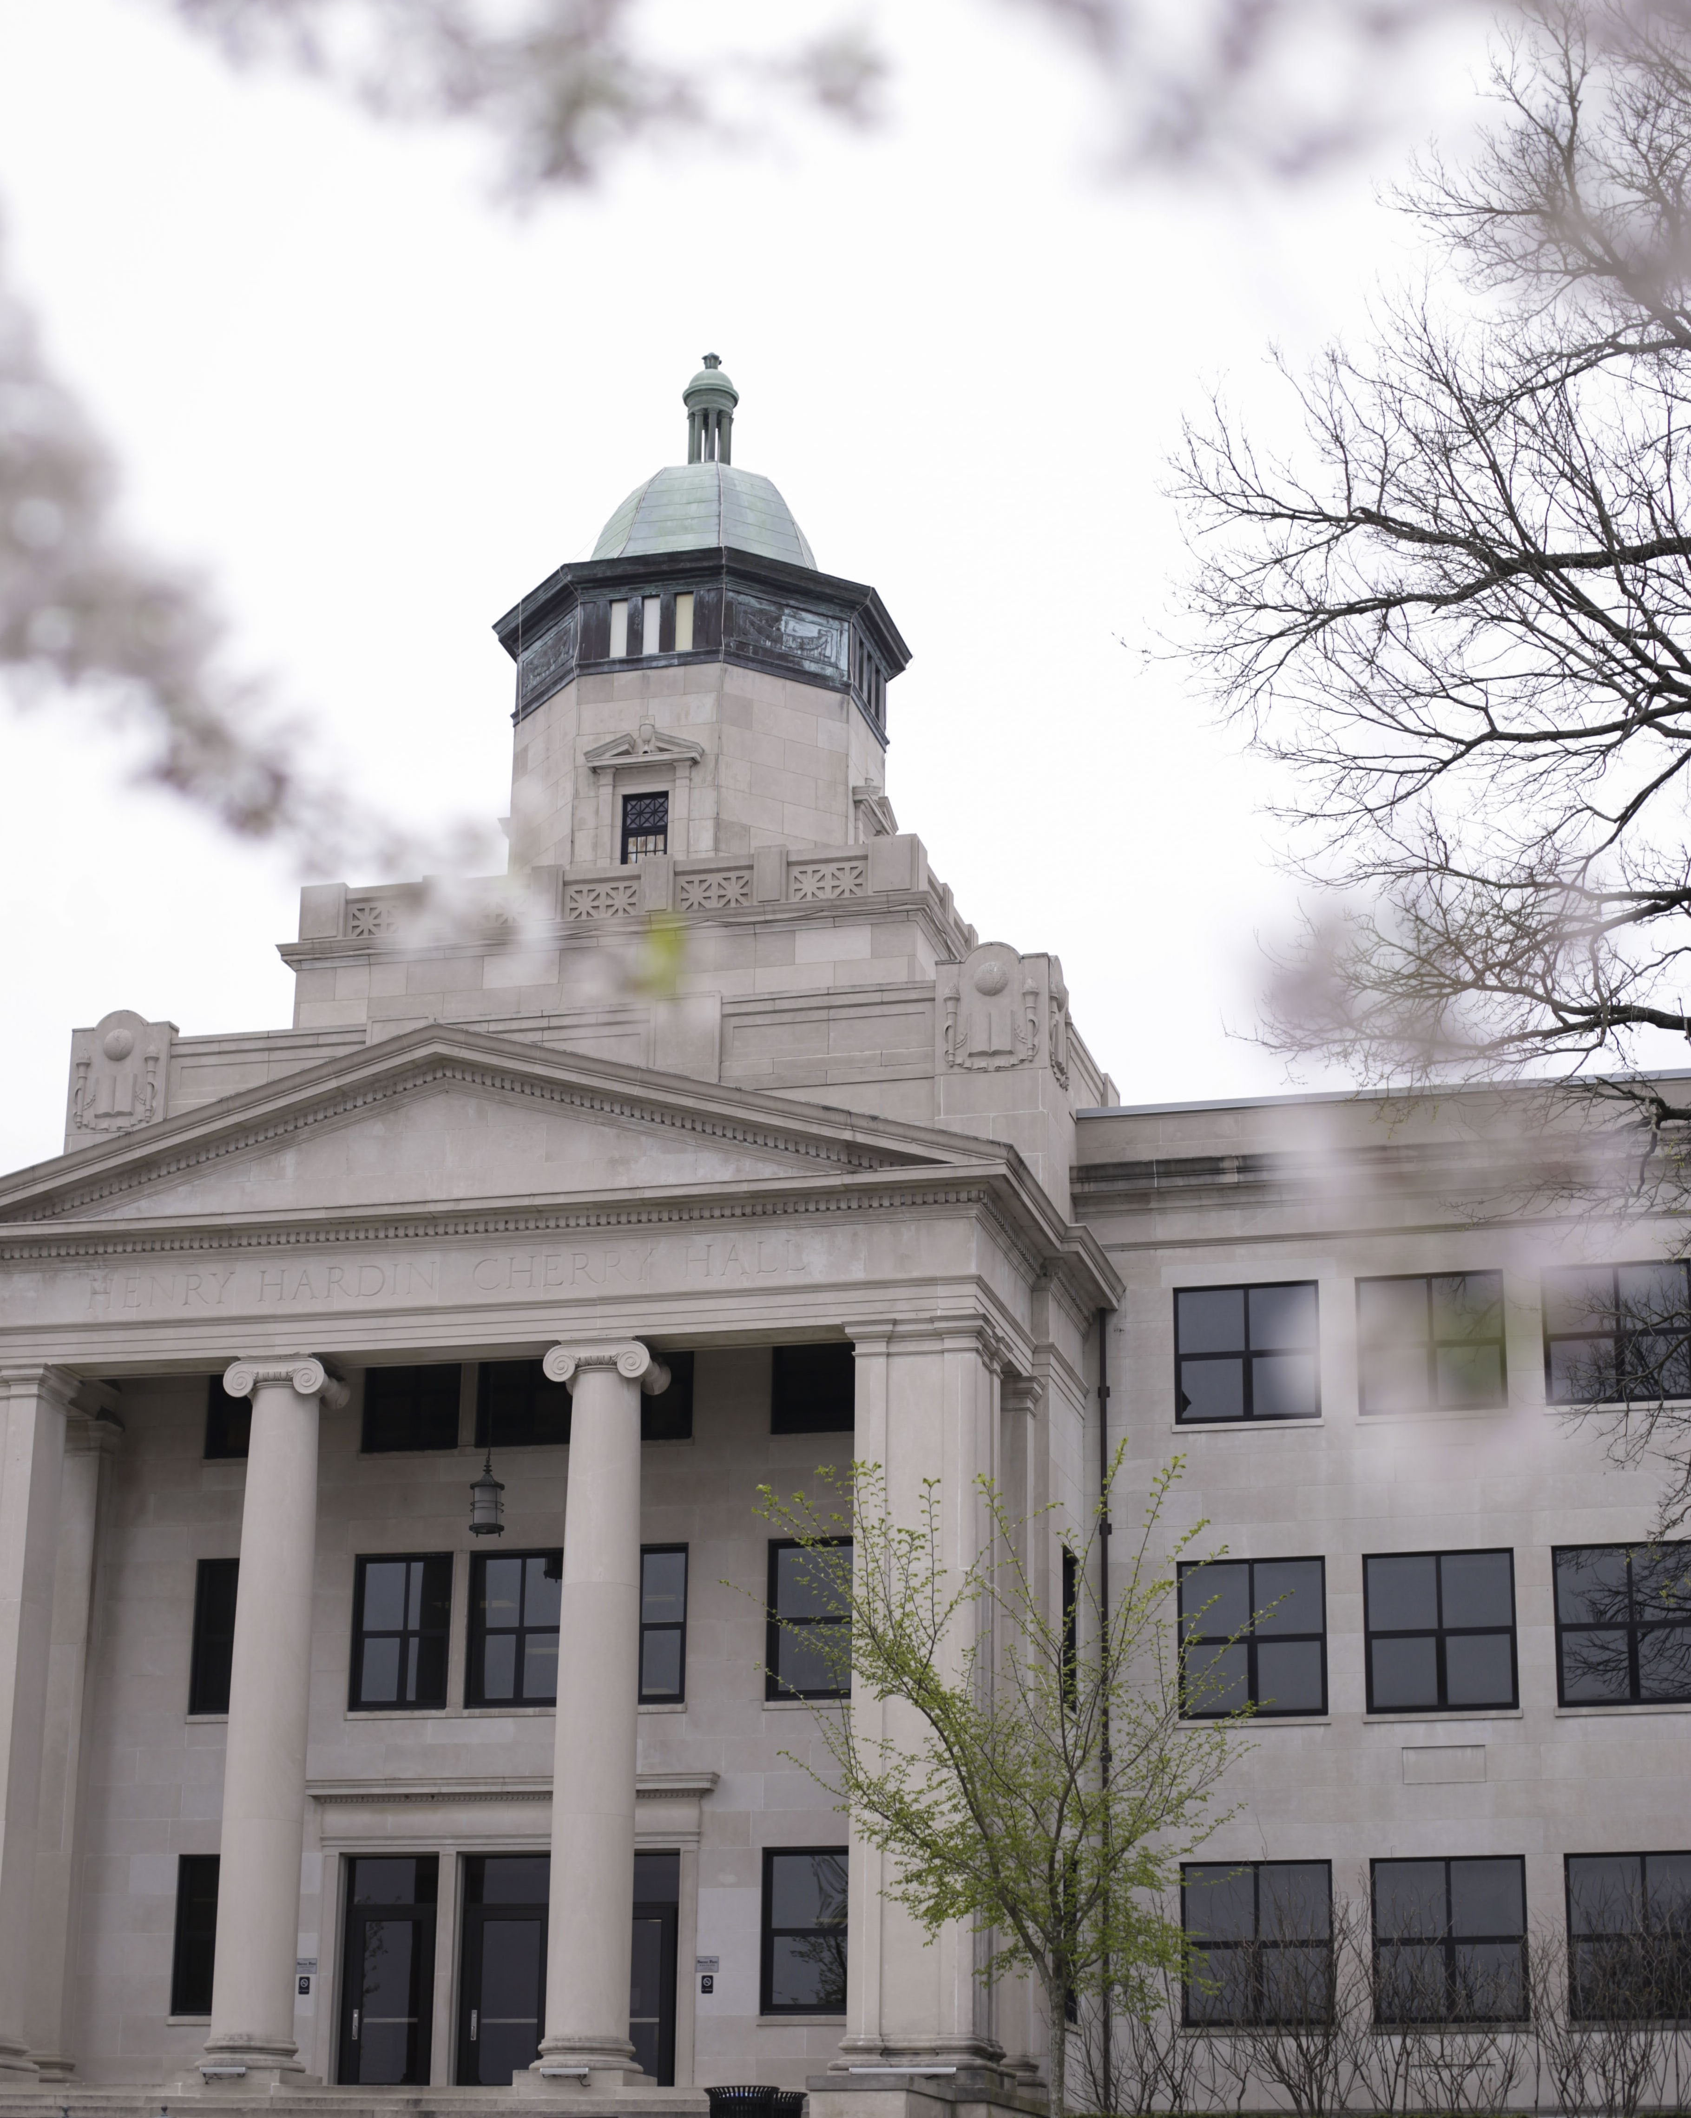
Lillian Golden
Noma Dunn Scholarship Fund

Slide 4
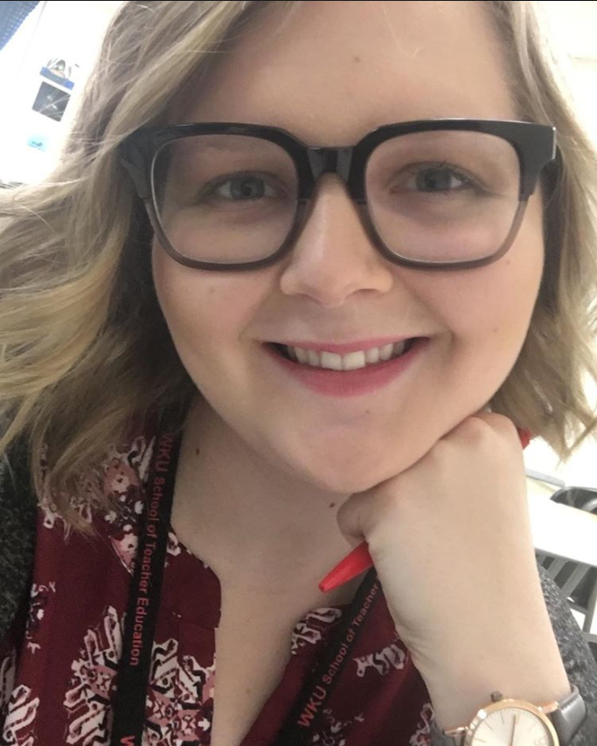
Sarah Lyons
Eva Rush Lee Scholarship

Slide 5
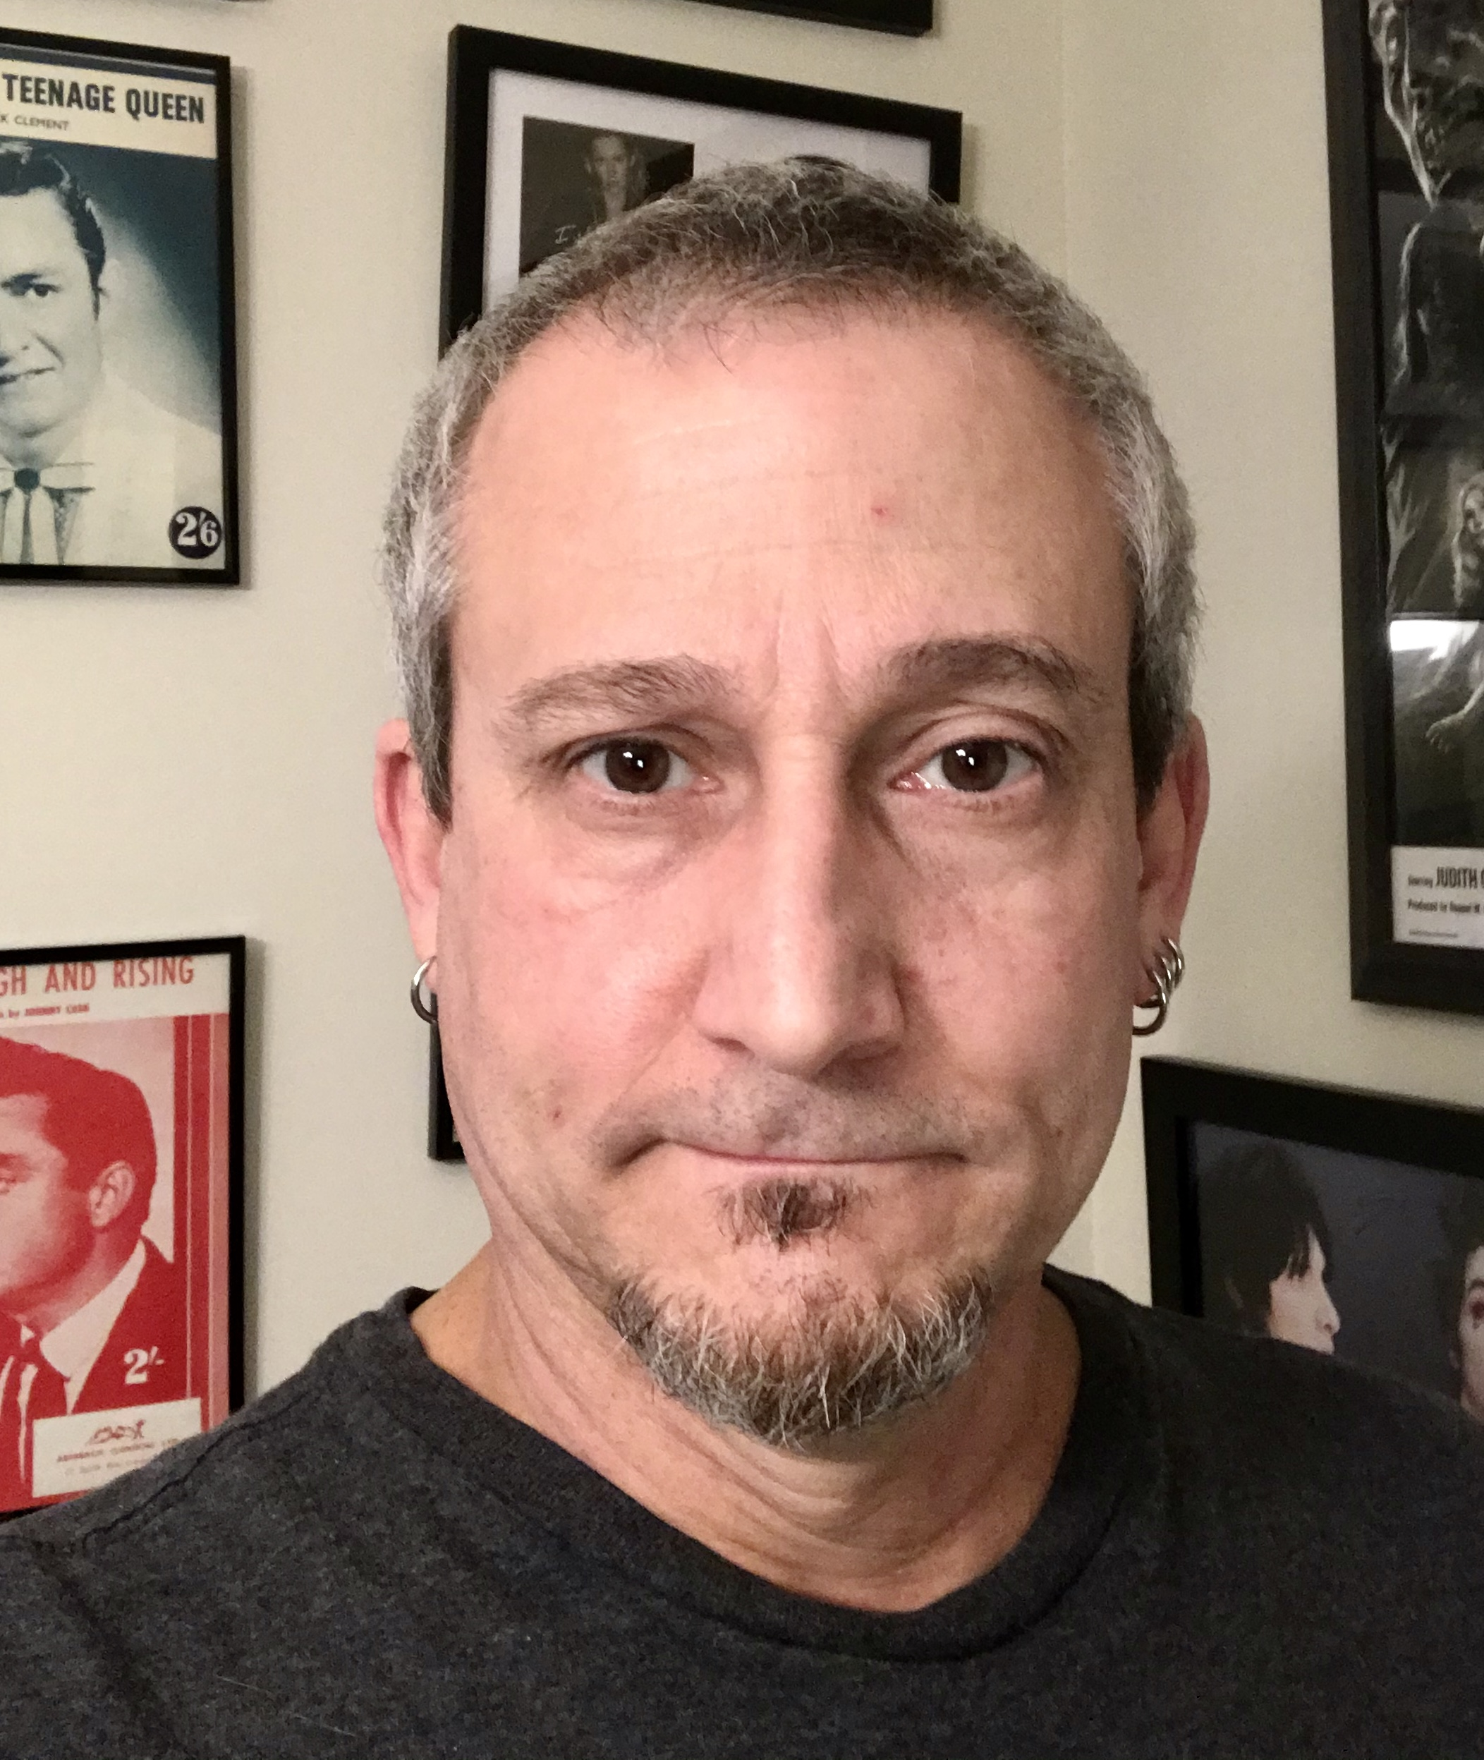
Phil Ciulla
Eva Rush Lee Scholarship

Slide 6
Faith Harris
Thomas G. Jones Scholarship Fund

Slide 7
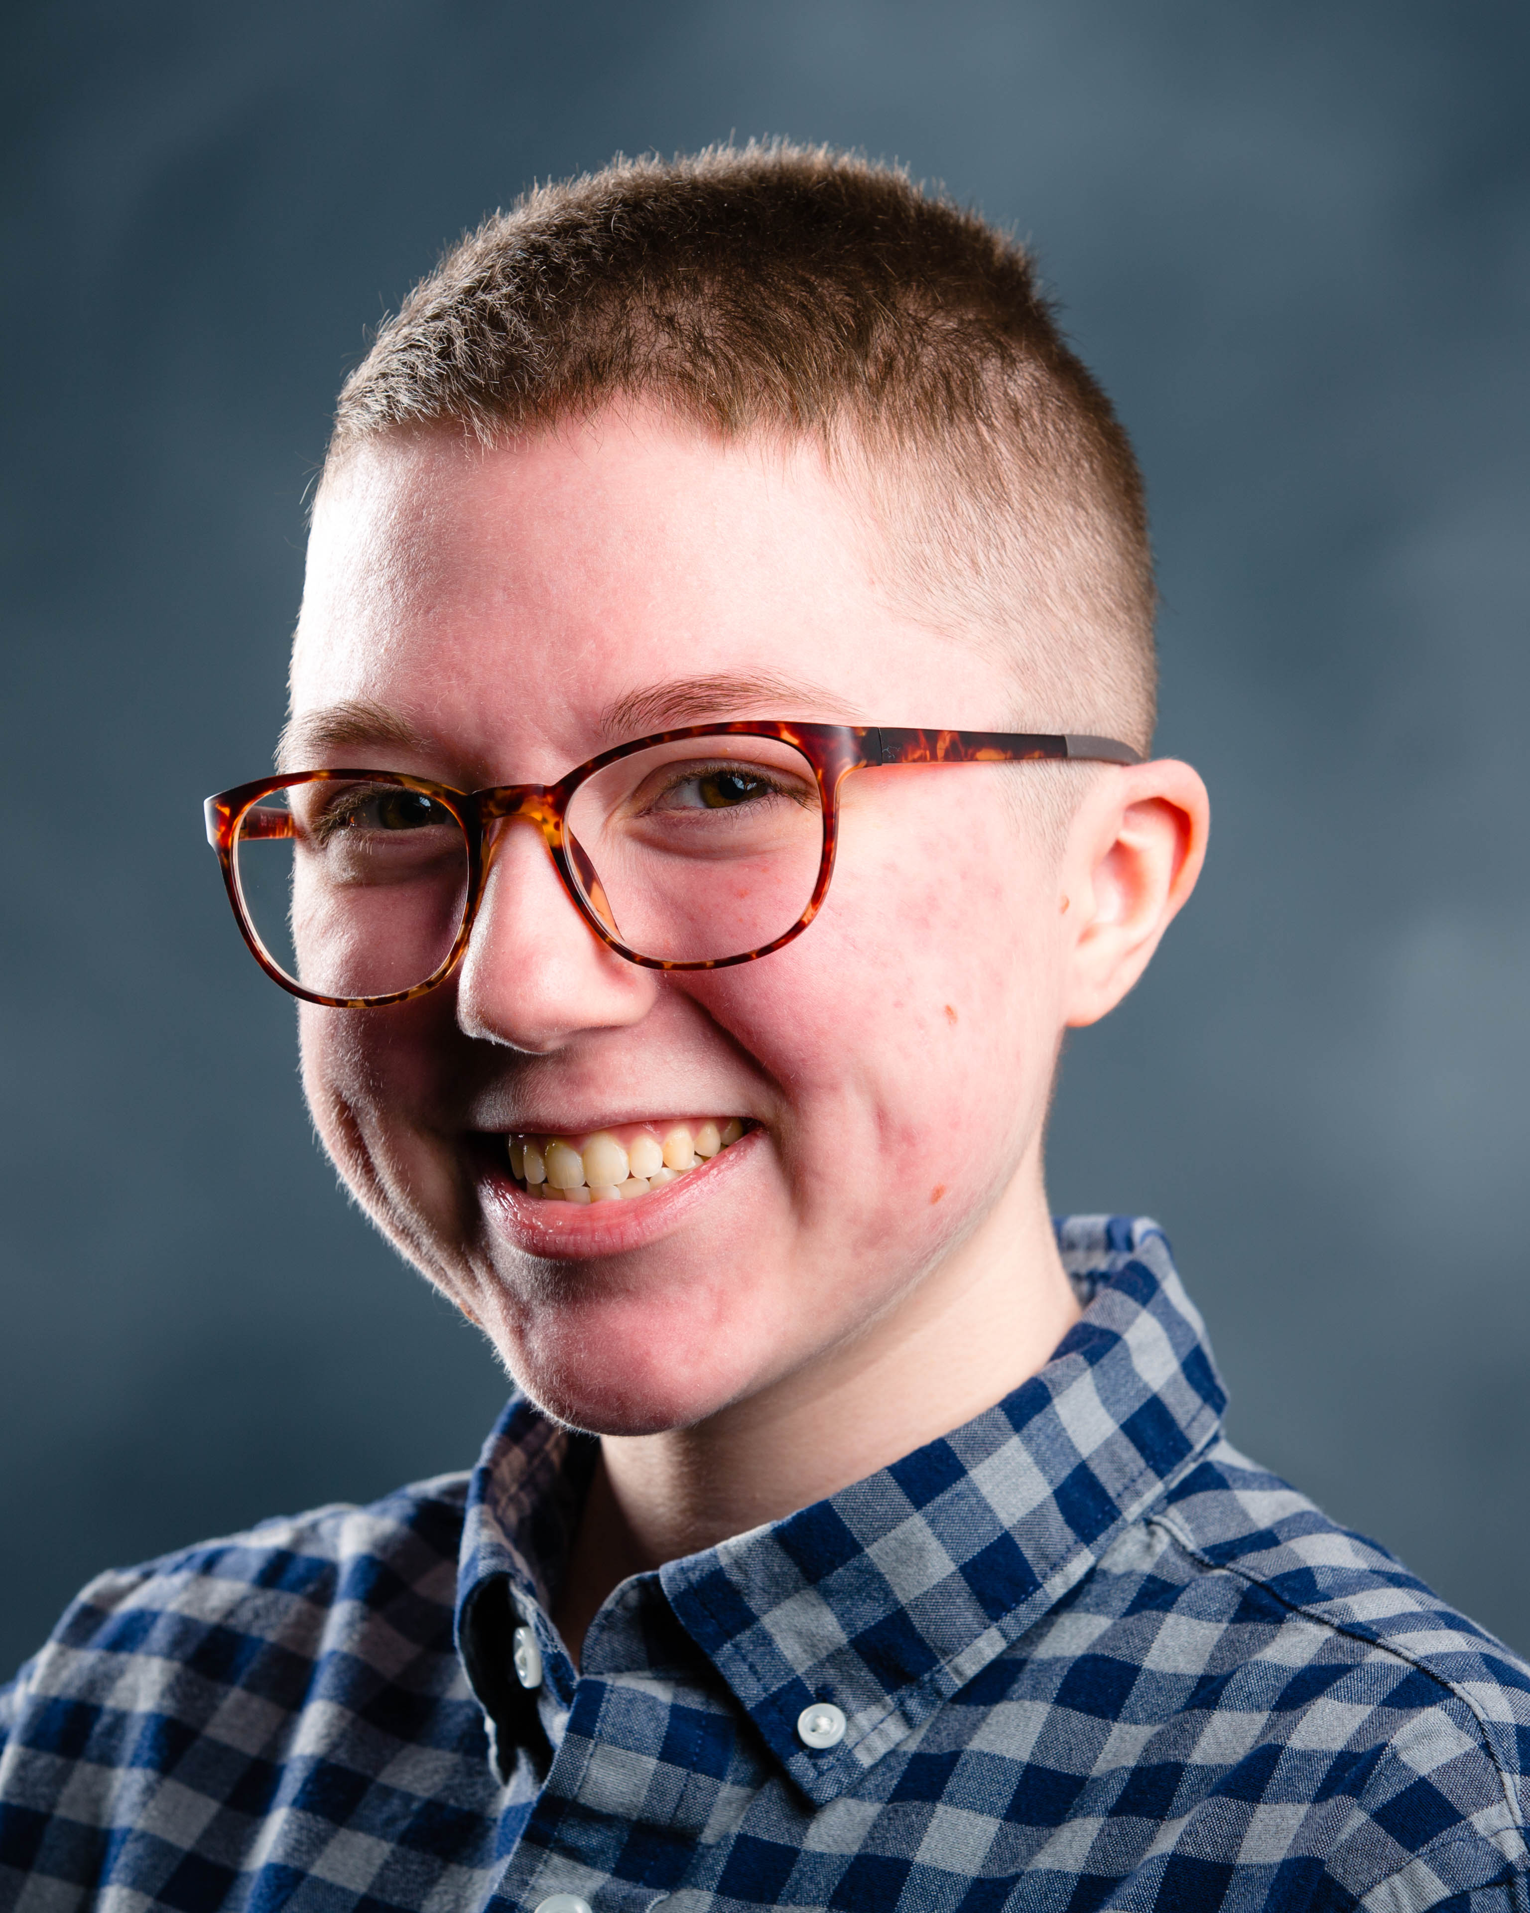
Max Chambers
2020 English Excellence Scholarship Award

Slide 8
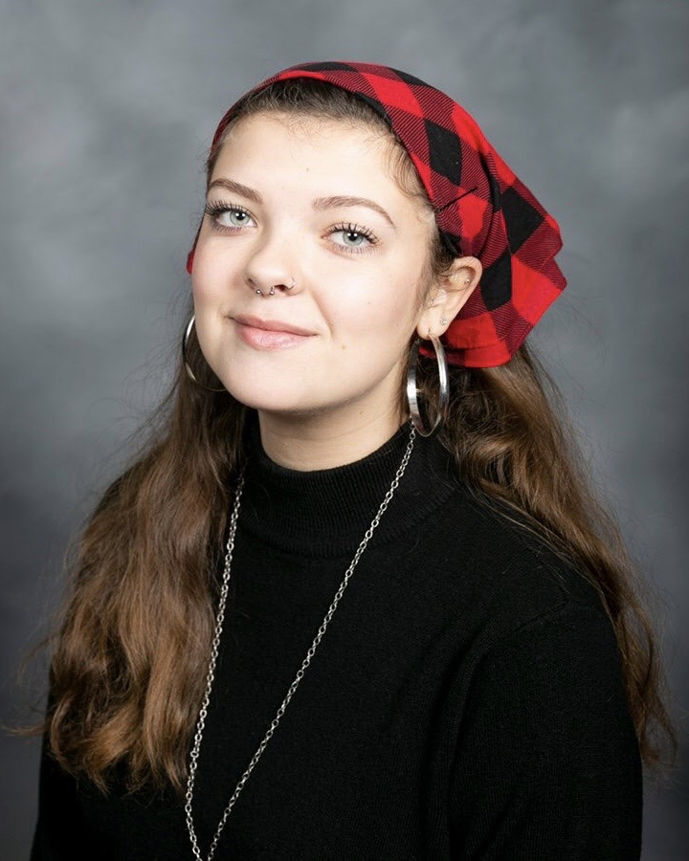
Bailey Cooke
Colonel Edgar Bryant and Edith R. Stansbury Scholarship Fund

Slide 9
Joseph Shoulders
Colonel Edgar Bryant and Edith R. Stansbury Scholarship Fund
2nd place in Robert Penn
Warren Essay Contest

Slide 10
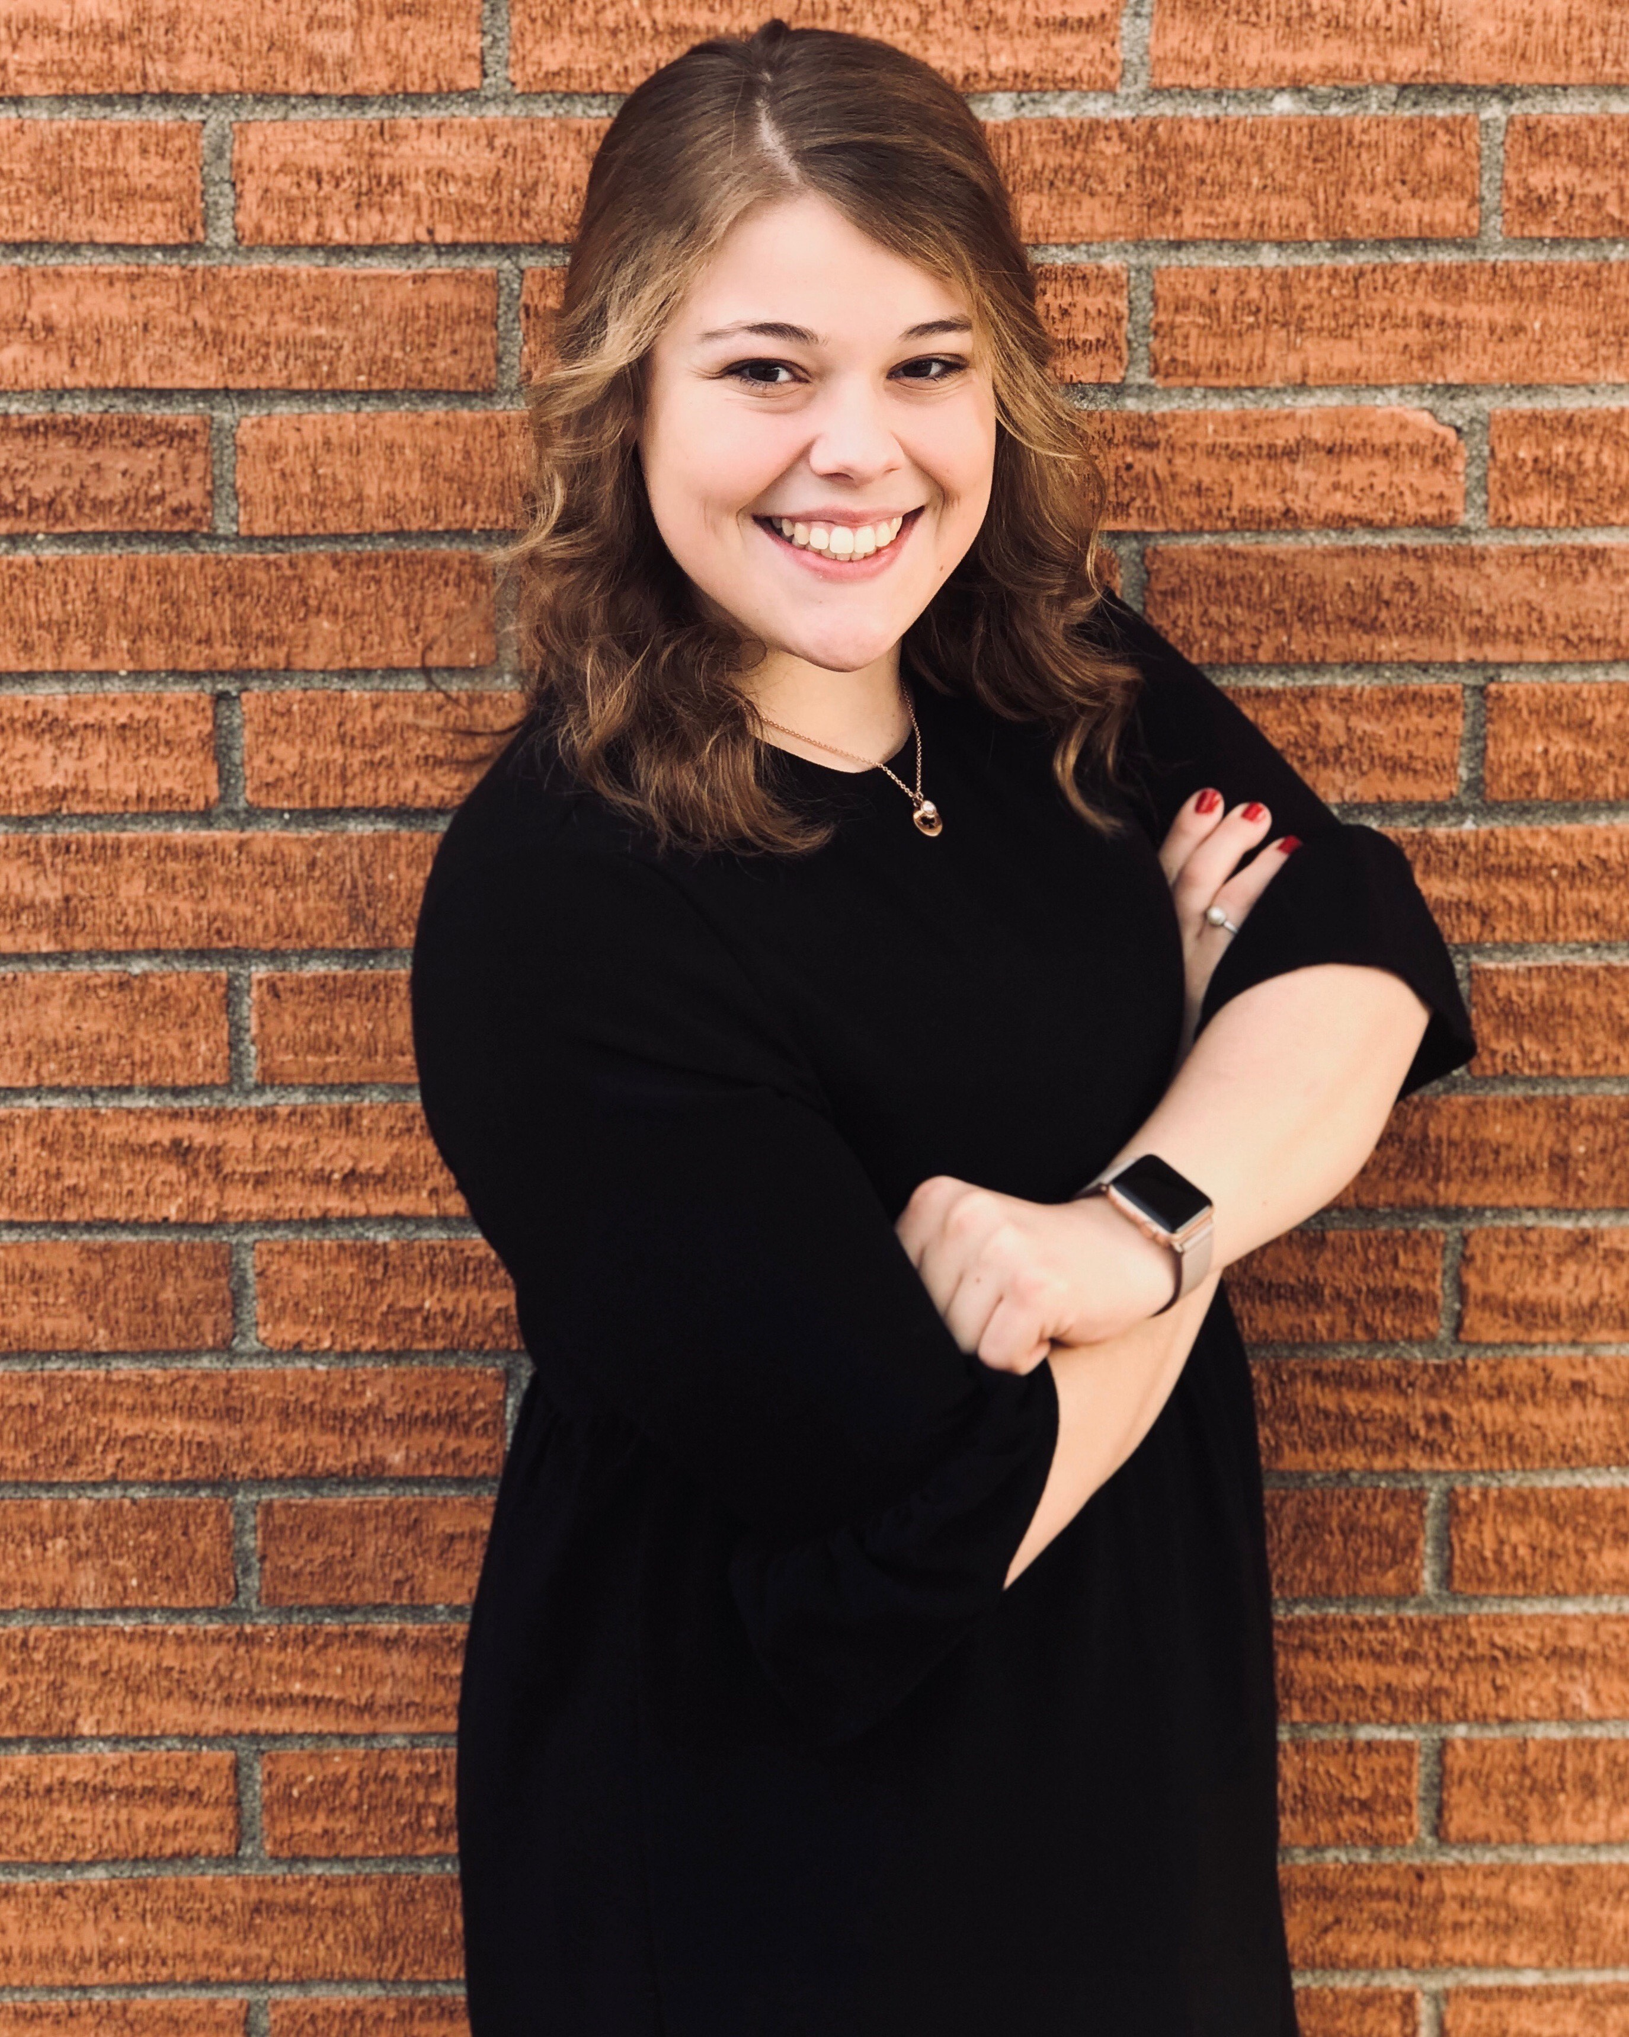
Hanna Van Winkle
Colonel Edgar Bryant and Edith R. Stansbury Scholarship Fund

Slide 11
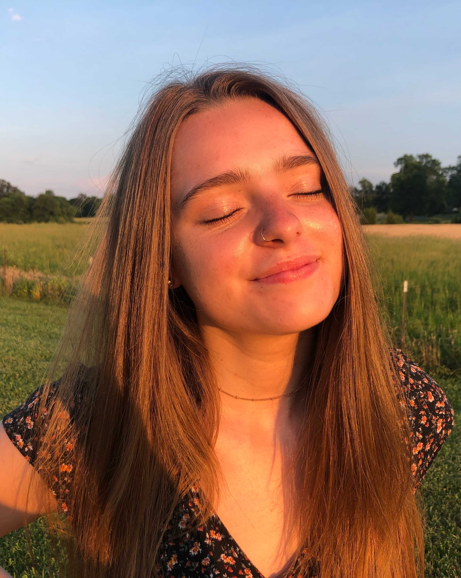
Julianna Lowe
Colonel Edgar Bryant and Edith R. Stansbury Scholarship Fund

Slide 12
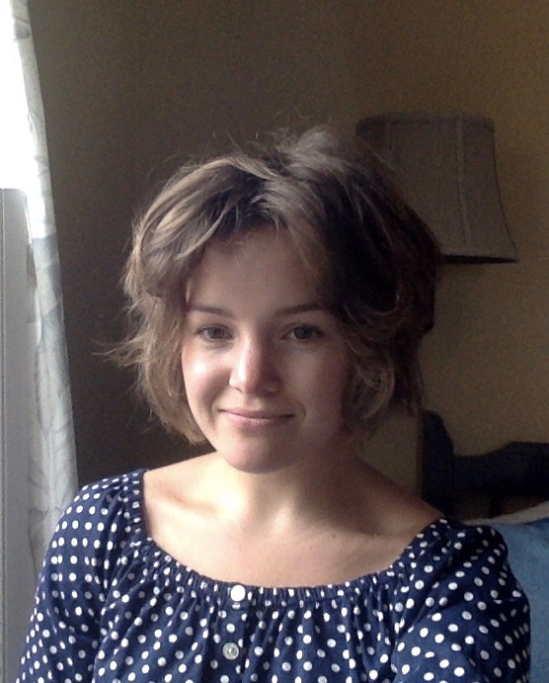
Ella Corder
Dr. Karen Pelz Scholarship Fund
Jim and Lana Flynn Study
Abroad Scholarship
2nd place in Mary Ellen and Jim Wayne Miller Celebration of Writing
2nd place in Goldenrod Poetry Festival

Slide 13
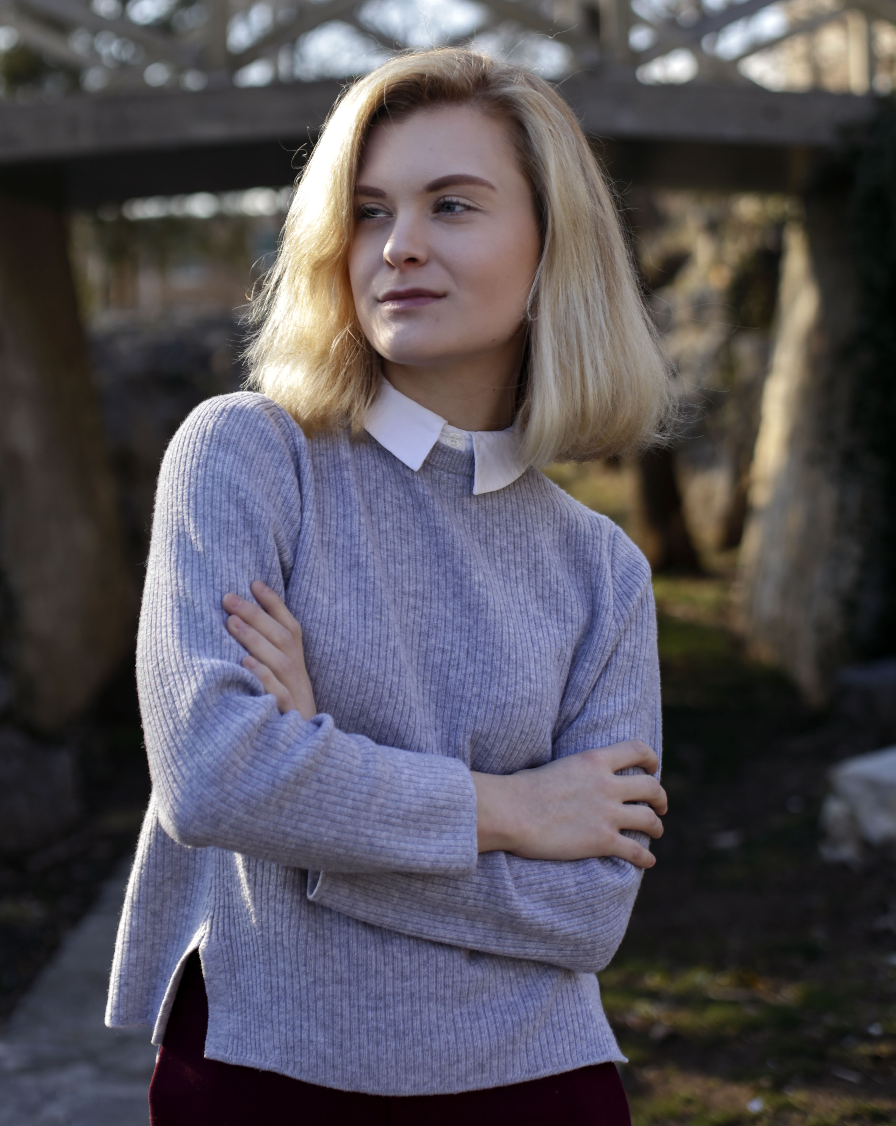
Lauren Sheppard
Jim and Lana Flynn Study Abroad Scholarship

Slide 14
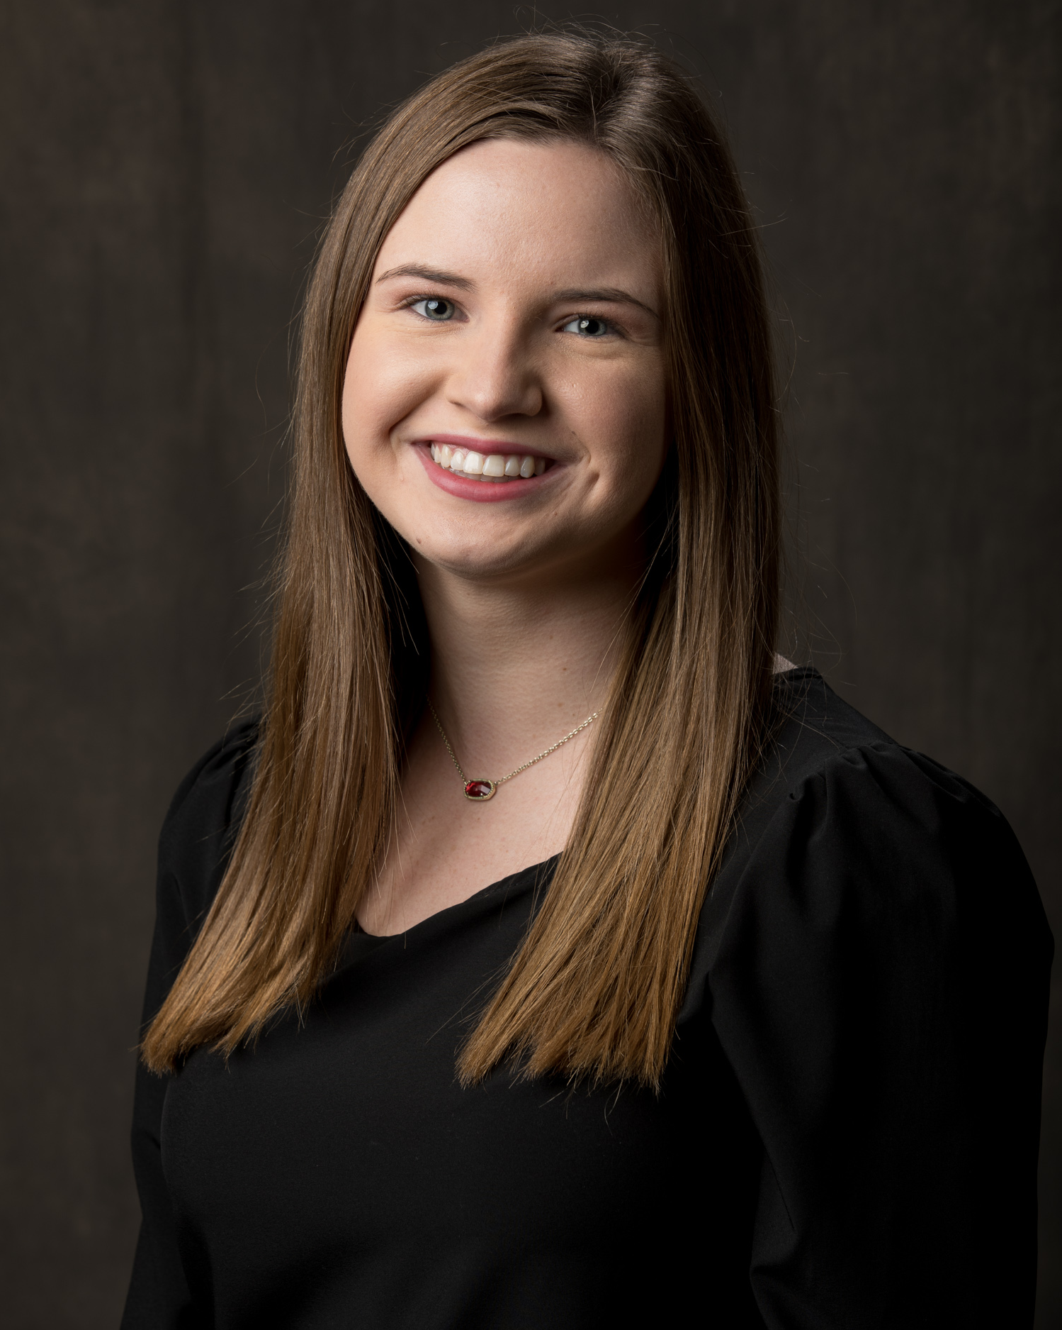
Fallon Russell
Dr. Nancy Hightower
Davis Scholarship

Slide 15
Brandon Peters
Earl A. and Cleo B. Moore— Terence E. and Sarah D. Kelsay Student Aid Fund

Slide 16
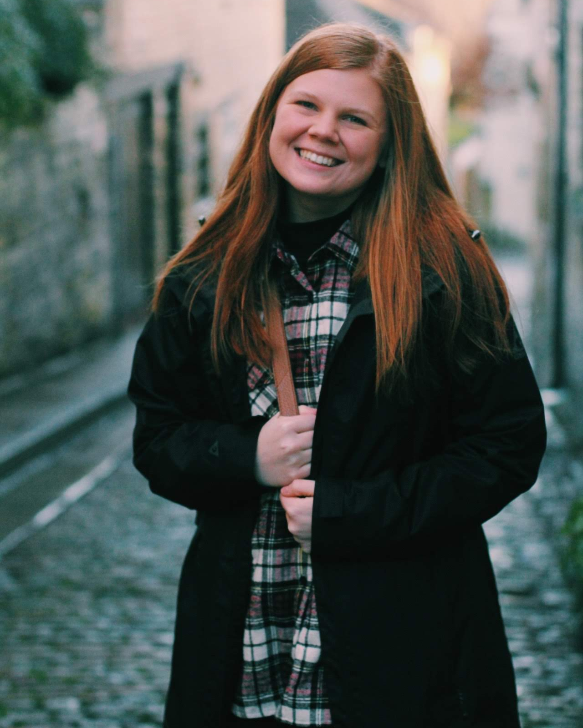
Bailey Alexander
Noma Dunn Scholarship Fund

Slide 17
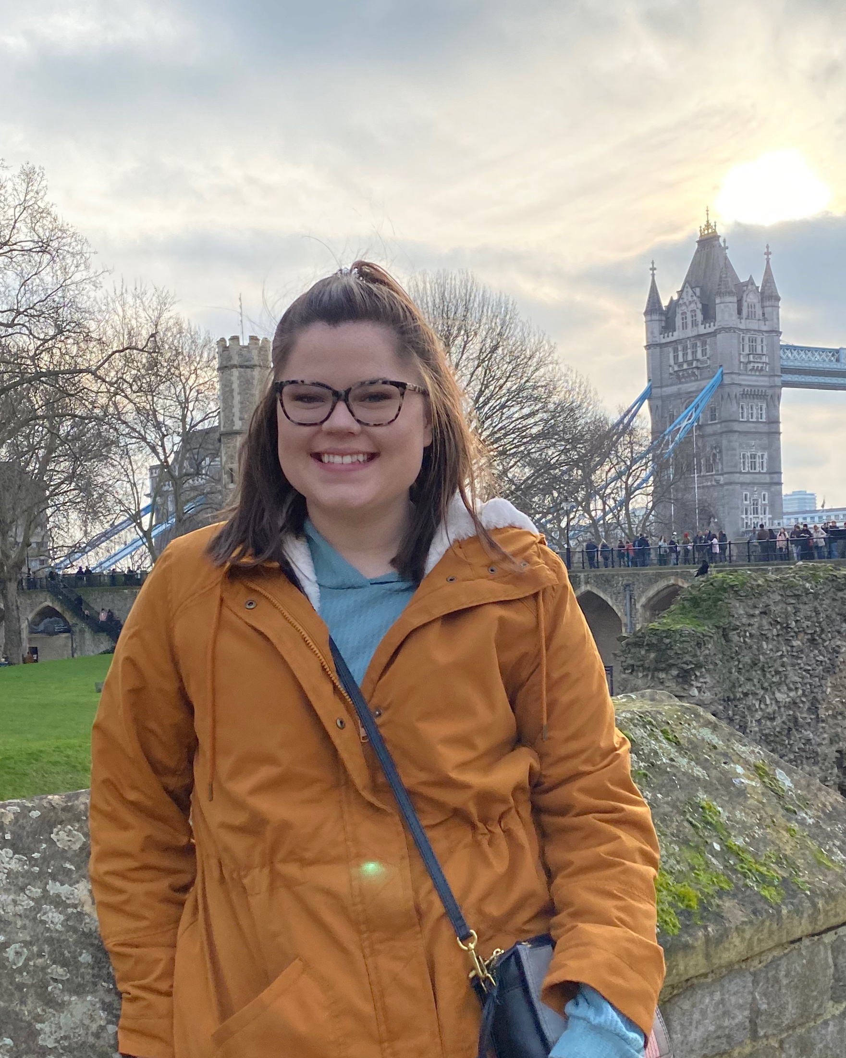
Chloe Benningfield
Patricia Minton Taylor English Literature Scholarship Fund

Slide 18
Olivia Allen
Mary Lucille Scott Scholarship Fund

Slide 19
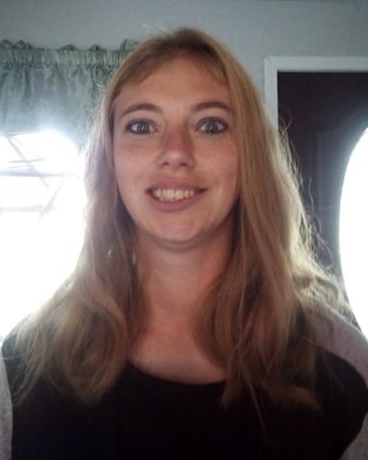
Amy Lindsey
Gladly Graduate Award

Slide 20
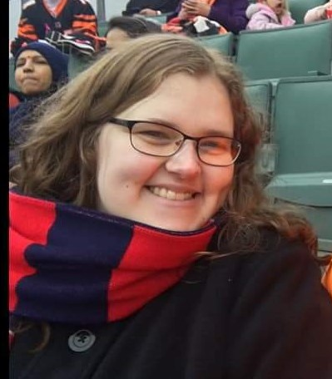
Chelsea Mathes
Wood Graduate Award

Slide 21
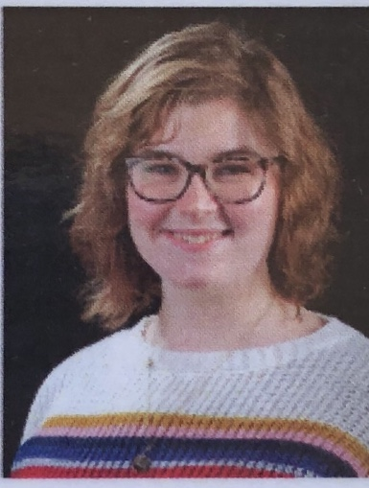
Catherine Sheffield
Wallace K. and Patience Nave Student Aid Fund

Slide 22
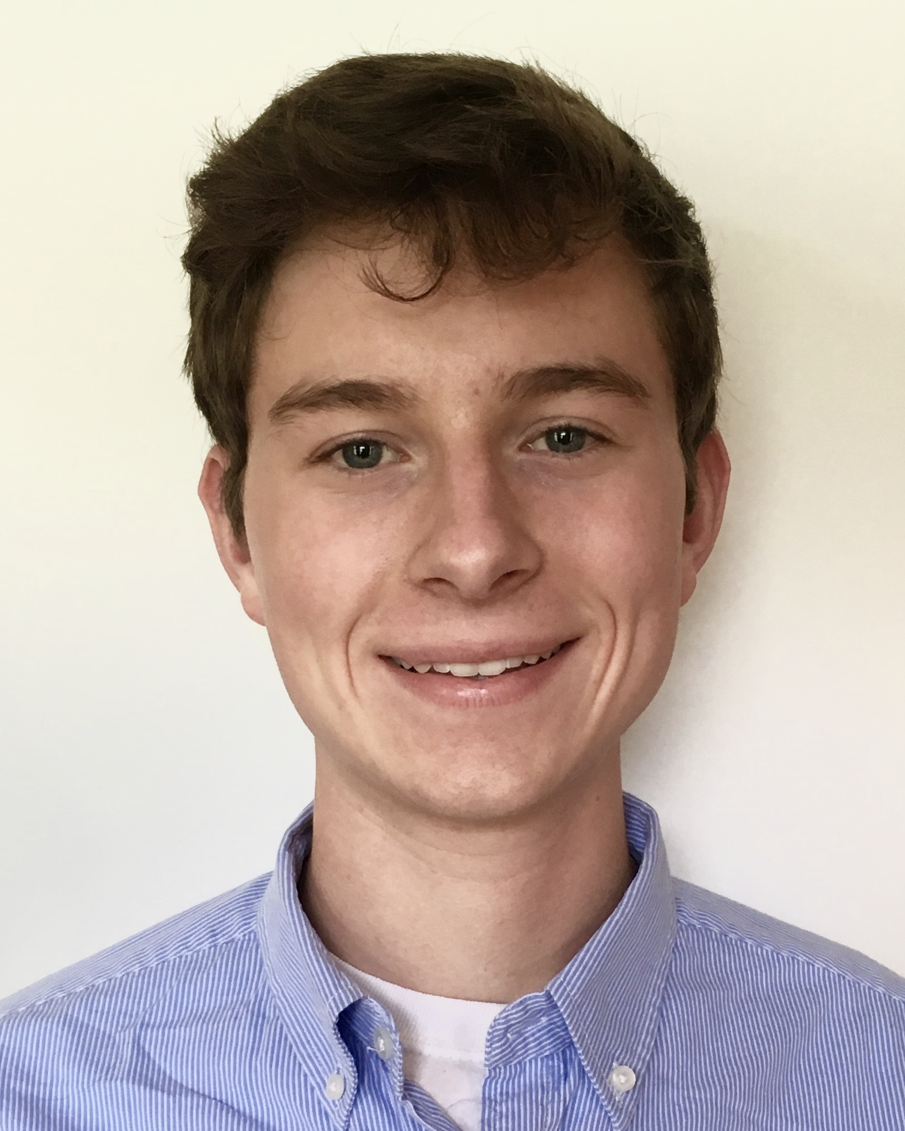
Carder Venable
Frank L. Atkinson Scholarship

Slide 23
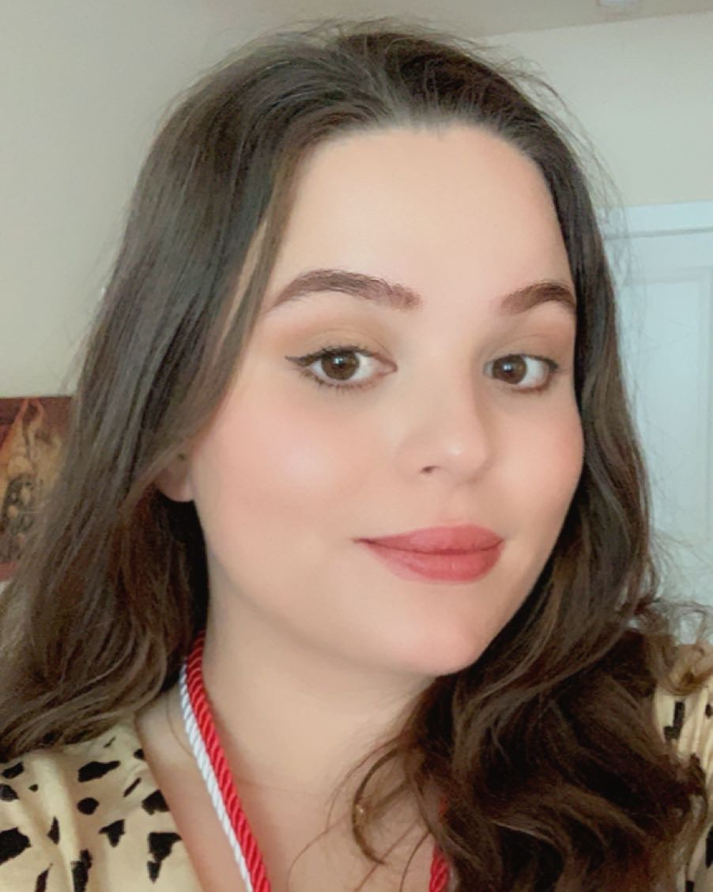
Sarah Olive
2020 Outstanding Graduating Student in Creative Writing
3rd place in Goldenrod Poetry Festival

Slide 24
Ava Miller
2020 Outstanding Graduating Student in English for Secondary Teachers

Slide 25
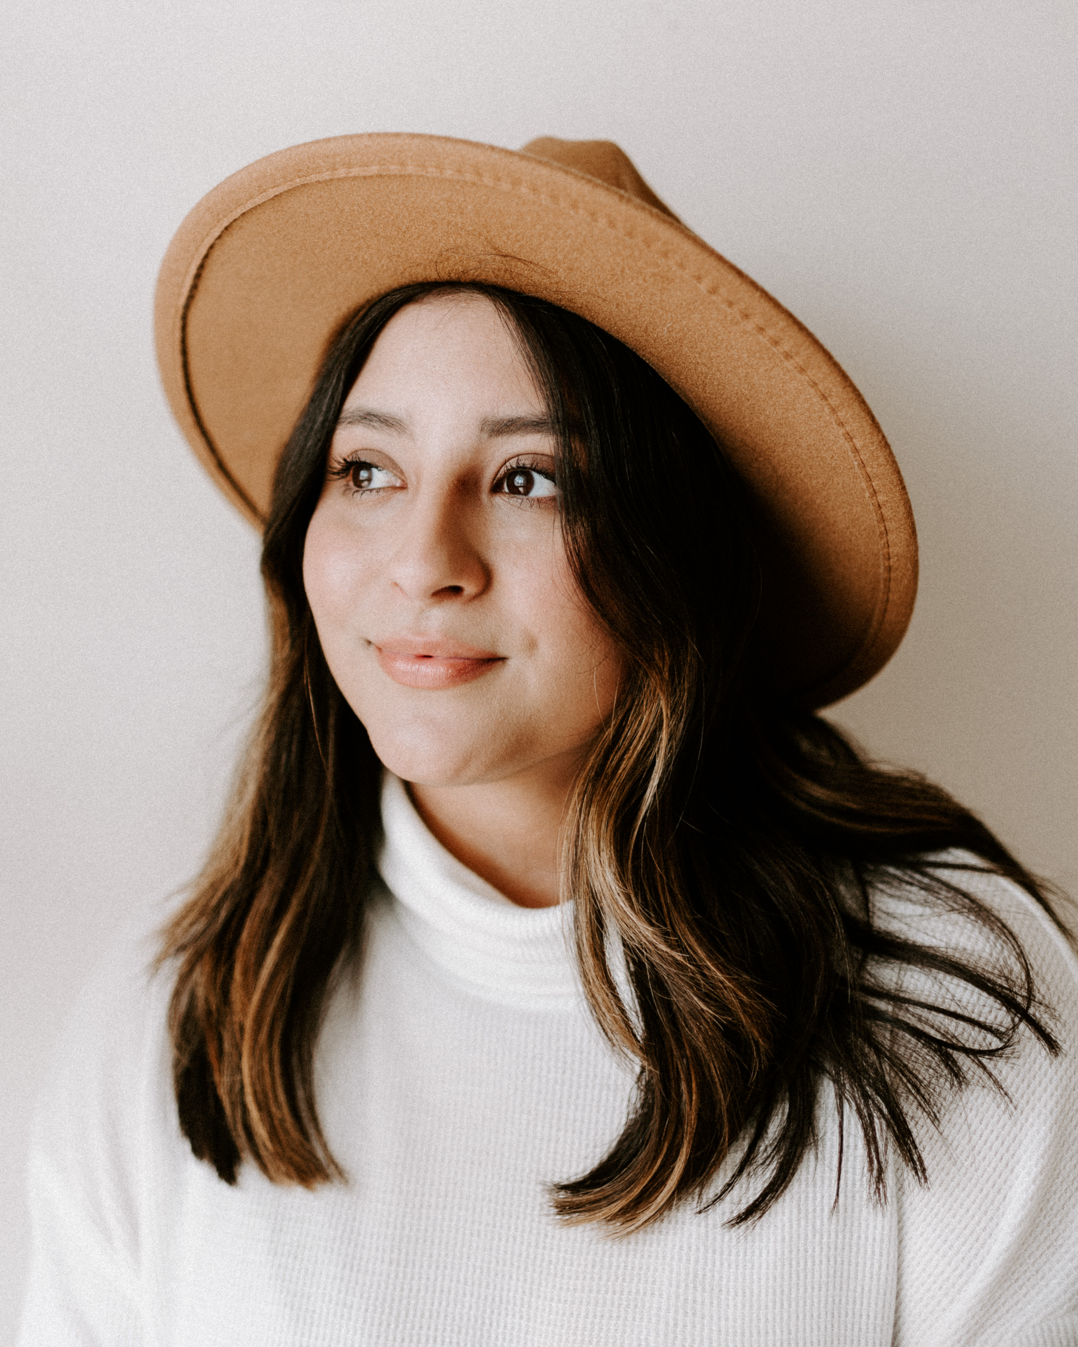
Keely Bartley
2020 Outstanding Graduating Student in Professional Writing

Slide 26
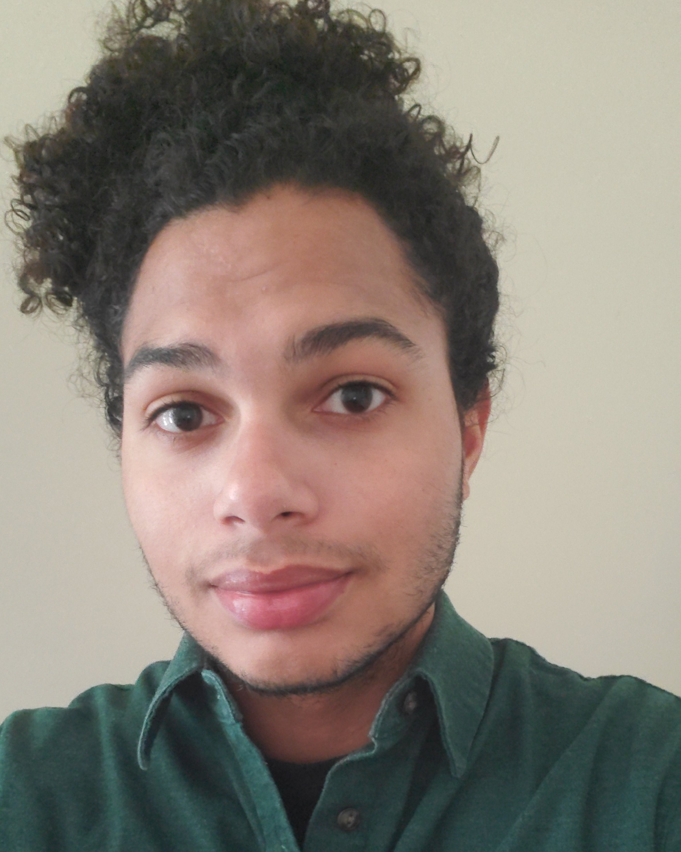
Chandler Moore
2020 Outstanding Graduating Student in Literature

Slide 27
Zachary Brandt
2020 Outstanding Graduating Student with a minor in TESOL

Slide 28
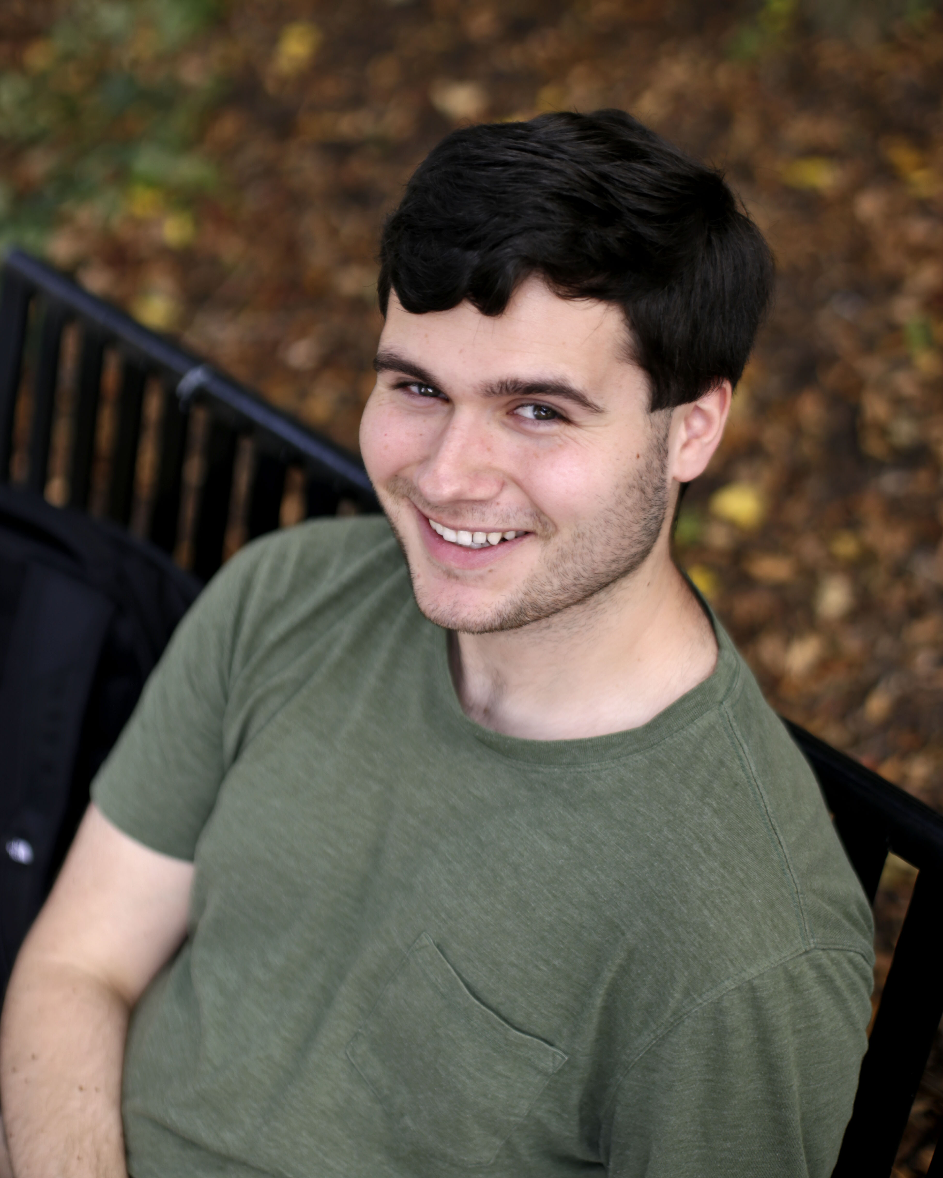
Cameron Fontes
1st place in Robert Penn
Warren Essay Contest

Slide 29
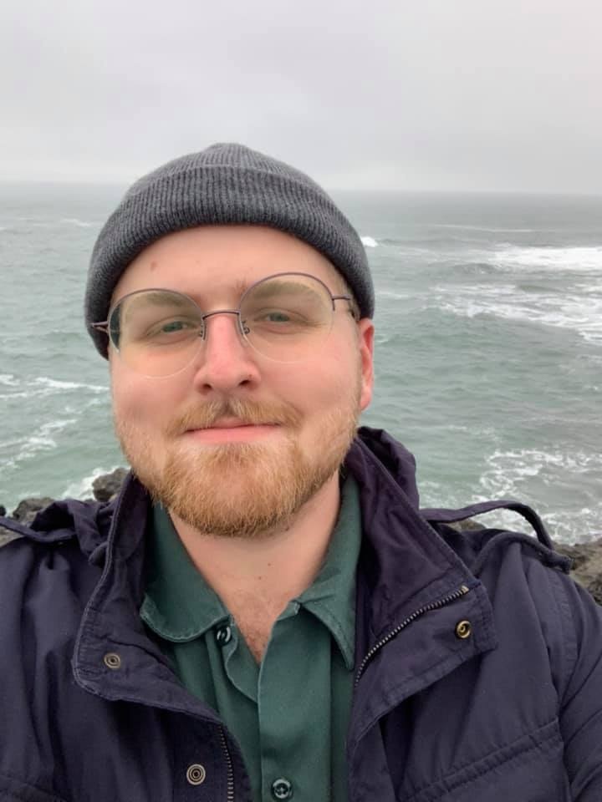
Noah Powers
1st place in Goldenrod
Poetry Festival

Slide 30
Seth Nevin
3rd place in Robert Penn
Warren Essay Contest

Slide 31
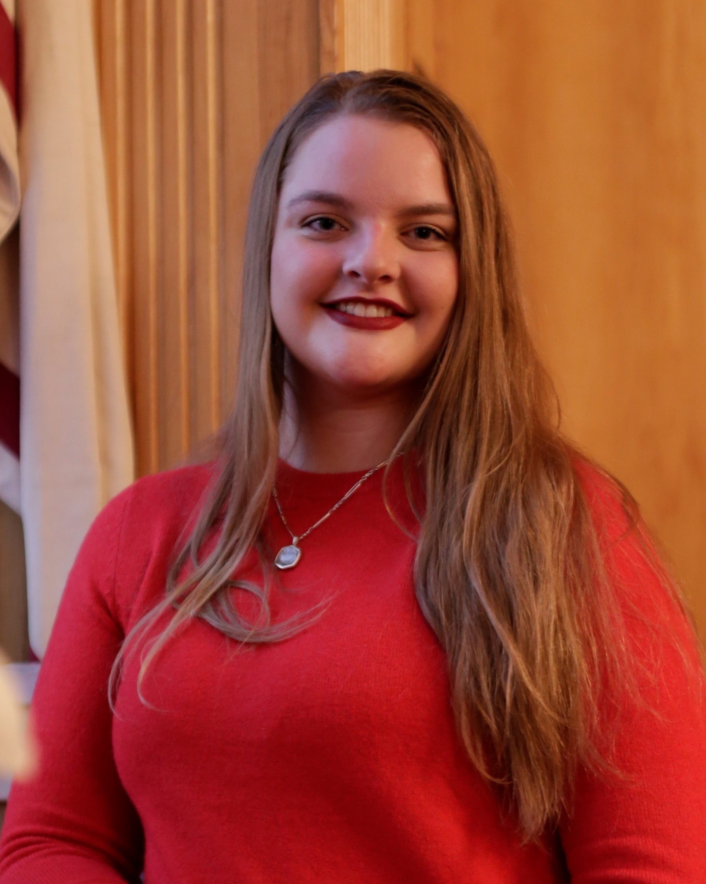
Aubrey Kelley
Earl A. Moore Scholarship Fund

Slide 32
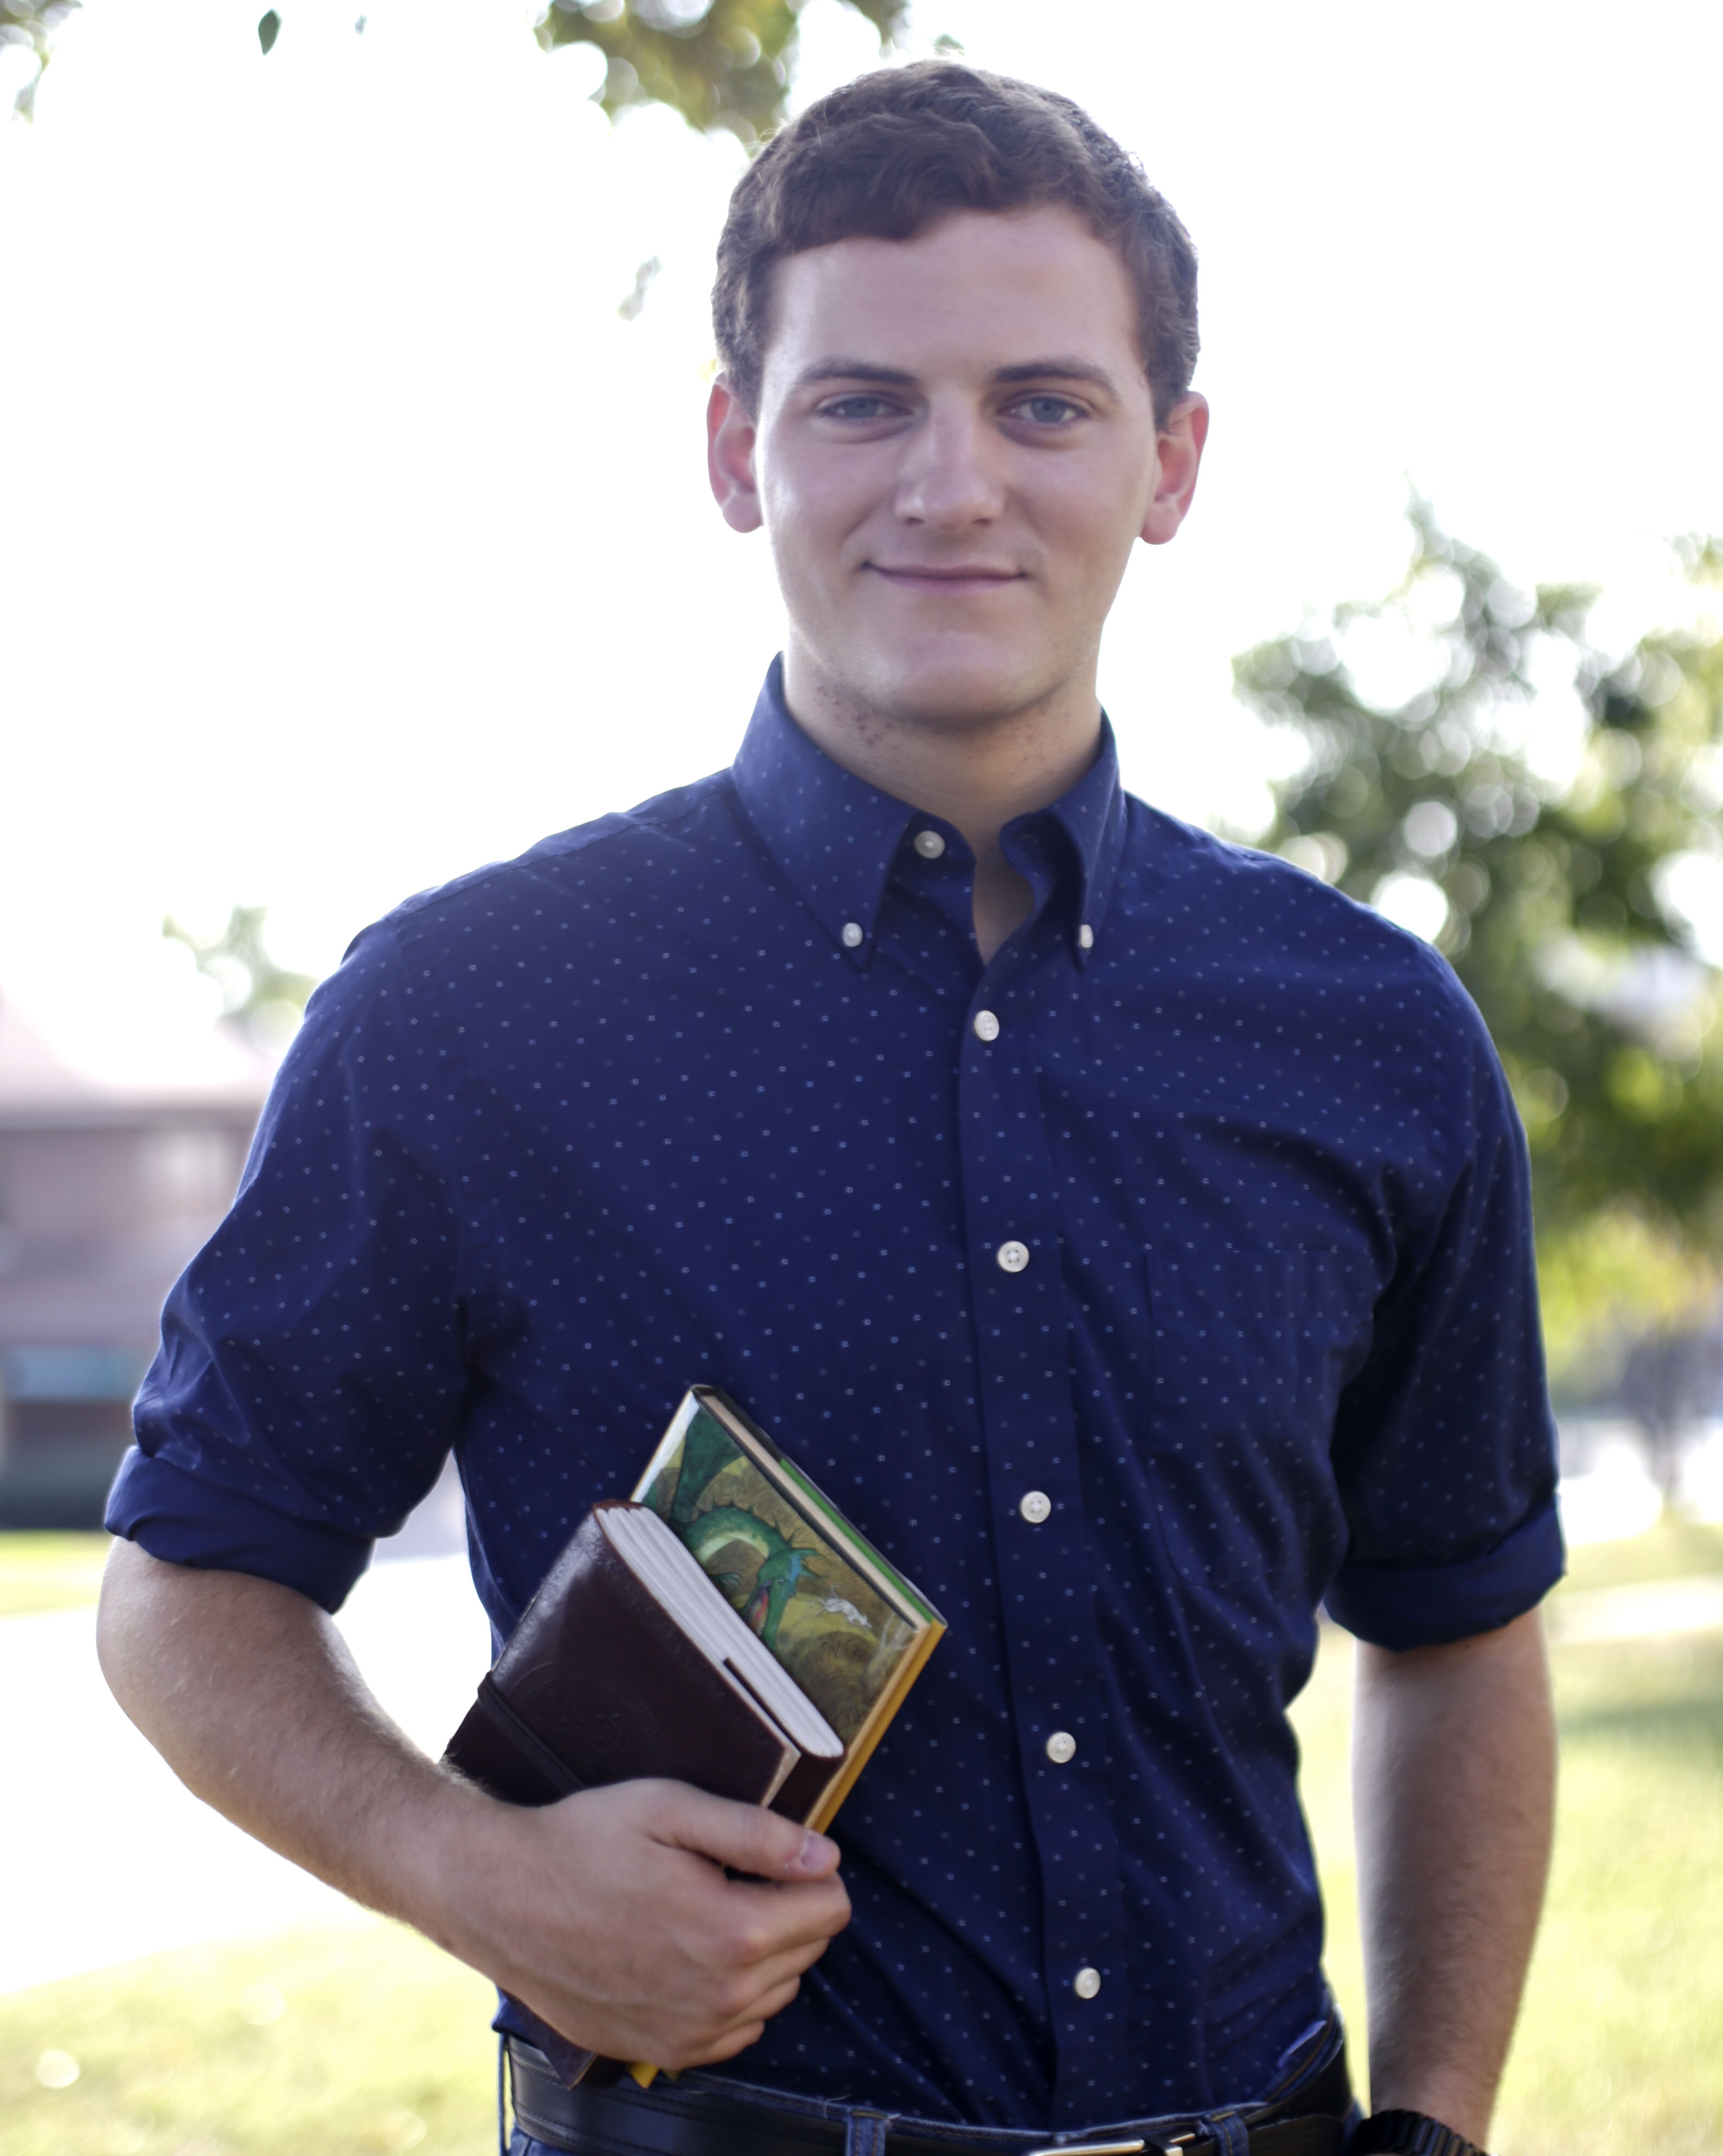
Dillon Miller
1st place in Annual Conference on Literature, Language, and Culture

Slide 33
Rachel Thomas
2nd place in Annual Conference on Literature, Language, and Culture

Slide 34
Rook Jones
3rd place in Annual Conference on Literature, Language, and Culture

Slide 35
Mikaila Smith
3rd place in Mary Ellen and Jim Wayne Miller Celebration of Writing

Slide 36
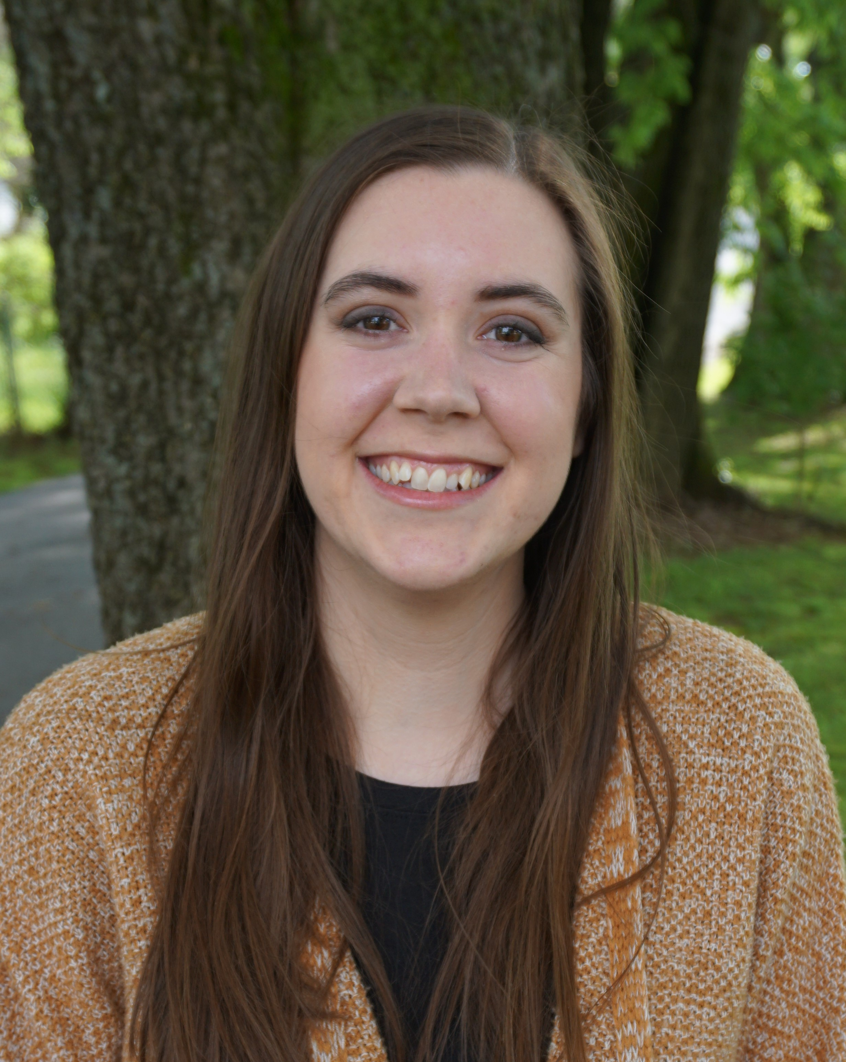
Alicyn Newman
1st place in Mary Ellen and Jim Wayne Miller Celebration of Writing

Slide 37
Johnathan Mansfield
Paul Bush Memorial Scholarship

Slide 38
Sigma Tau Delta Conference participants
May Quaid Carder Venable
Elizabeth Roth Lauren Sheppard
Catherine Sheffield Dillon Miller
Eli Edens Joseph Clardy
Adrianna Waters Brittany Gruber
Ella Corder Megan Hutchinson
Hayley Watson

Slide 39
Zephyrus Winners
Jim Wayne and Mary Ellen Miller Poetry Award
Sarah Olive, “When I Attempt Ardha Chandrasana/’Half Moon Pose’”
Browning Literary Club Poetry Award
Mara Lowhorn, “Florence”
Ann Travelstead Fiction Award of the Ladies Literary Club
Mikaila Smith, “Blackfish”
Wanda Gatlin Essay Award
Noah Powers, “Ruminations at the Grand Canyon”
Zephyrus Art Award
Daniel Nausa, Untitled

Slide 40
Ashen Egg Contributors
Hannah Bushon
“Scientology: The Cult of Religion”
Max Chambers
“Writing Technologies in Comparison: Security in the
Ages of Telegrams and WhatsApp”
Isabel Eliassen
“Chinese Character Simplification through the
Lens of Corpus Planning”
Cameron Fontes
“’And yet you’ve done the most for us’: The Realities
of Aging in Tokyo Story”
Jordan Fries
“No One Mourns the Wicked: Translation and
Perception of Grendel’s Mother”
Julianna Lowe
“Catalyst for Change: Analyzing the Impact of Creative Writing on the Feminist Movement”
Sarah Lyons
“The Political Gun Debate: Targeting Presuppositions in Contrasting Political Cartoons”
Dillon Miller
“Voltaire and Virtue”
McKenzie Morris
“Shifting the Conversation: Confronting Colonial Stereotypes in Things Fall Apart”
Carder Venable
“Keats’ Nightingale and Hardy’s Thrush: Birds of a Feather That Do Not Flock Together”
Adrianna Waters
“Spinning Stereotypes: Shahrazad’s Storytelling Skills in ‘Sinbad the Sailor’”

