Slide 1
Project RAP: Cluster Grouping Component
Dr. Julia Roberts, Dr. Mary Evans
and Dr. Tracy Inman
Western Kentucky University

Slide 2
If during the first five or six years of school, a child earns good grades and high praise without having to make much effort, what are all the things he doesn’t learn that most children learn by third grade?

Slide 3
Think about…
Two of the most gifted people you personally know or have known
Jot down descriptions for one and then flip your paper over and describe the other one.

Slide 4
What stands out?
What do the two individuals have in common?
In what ways are the two individuals very different?

Slide 5
Gifted children are an incredibly diverse population: Characteristics are often at the extremes on the continuum. Example: Organizational skills, risk taking, personality (outgoing or reserved).

Slide 6
Advanced learners are often frustrated when little or no differentiation occurs in a classroom.

Slide 7
How do you feel when you are stuck in traffic, especially when the traffic is very slow moving or not moving at all?

Slide 8
The needs of gifted children and young people are created by their strengths – not by deficits. Consequently, they don’t look needy.

Slide 9
Kentucky Gifted Regulations

Slide 10
Exceptional Children
Kentucky includes children identified with gifts and talents as category of exceptional children
Benefits
Due Process
Identification
Services
Individual Education Plan
Kentucky: Gifted Students Service Plan (GSSP)
Matches a formally identified gifted student’s interests, needs and abilities to differentiated service options and serves as the vehicle between the parents and the school personnel.
Parental input
Progress reports
Legal document
Person(s) signing the GSSP are responsible

Slide 11
Kentucky Law (KRS 157.200ln) includes five categories of gifted: - General Intellectual - Specific Academic - Leadership - Creativity - Visual and/or Performing Arts

Slide 12
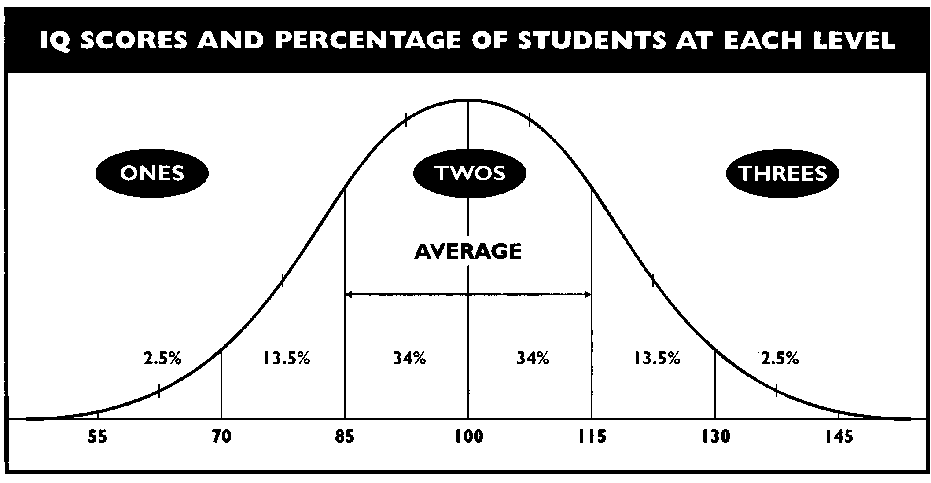
Winebrenner, S. (2001)

Slide 13
Identification Vs Selection
Formal Identification
Grades 4 to 12
Informal Selection
Primary Talent Pool
Formal identification occurs in grade 4.
At least three valid and reliable measures must be used e.g., portfolios, checklists, formal testing, anecdotal records, etc.
Parental permission must be obtained.
High potential learners means those students who typically represent the top quartile of the entire student population in terms of the degree of gifted characteristics and behaviors in grade P1-P4.
At least three informal measures must be utilized in placement.
Parental permission must be obtained.

Slide 14
Primary Talent Pool
Section 1. (31) “Talent pool” means a group of primary students informally selected as having characteristics and behaviors of a high potential learner and further diagnosed using a series of informal and formal measures to determine differentiated service delivery needs during their stay in the primary program.

Slide 15
Section 3. (7) In the primary program, formal, normed measures may be used for diagnosing the level of instructional service needed by a student and for evaluation of student progress. Data from formal, normed measures shall not be used for the purpose of eliminating eligibility for services to a child in the primary program but may be used to discover and include eligible students overlooked by informal assessment.

Slide 16
Section 6. (2) For a student in a primary program, services shall be provided within the framework of primary program requirements and shall allow for continuous progress through a differentiated curriculum and flexible grouping and regrouping based on the individual needs, interests, and abilities of the student.

Slide 17
Section 6. (3) Emphasis on educating gifted students in the general primary classroom, shall not preclude the continued, appropriate use of resource services, acceleration options, or the specialized service options contained in subsection (5) of this section. A recommendation for a service shall be made on an individual basis.

Slide 18
Section 6. (4) Grouping for instructional purposes and multiple services delivery options shall be utilized in a local district gifted education plan. Student grouping formats shall include grouping for instructional purposes based on student interests, abilities, and needs, including social and emotional.

Slide 19

Curriculum
A school shall differentiate, replace, supplement, or modify curricula to facilitate high level attainment of the learning goals established in KRS 158.6451 and to assist students identified and diagnosed as gifted and talented to further develop their individual interest, needs, and abilities

Slide 20
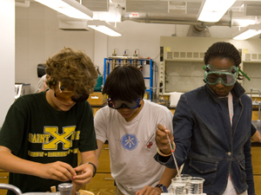
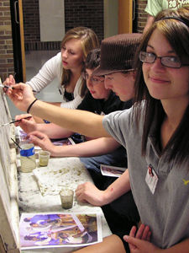
Multiple Services
There shall be multiple service delivery options with no single service option existing alone, district-wide, at a grade level. These service delivery options shall be differentiated to a degree as to be consistent with KRS 157.200 (1).

Slide 21
Service Options
Acceleration
Advanced Placement and Honors Courses
Collaborative Teaching and Consultation Services
Competitions
Concurrent College Enrollment/Dual Credit
Differentiated Study Experiences for Individuals and Cluster Groups in the Regular Classroom
Distance Learning/Internet Courses
Enrichment Service During the School Day
Independent Study
International Baccalaureate
Magnet Schools/ Self-contained Classrooms
Mentorships
Seminars
Special Counseling Services: Group and Individual
Summer Programs
Travel Study Options

Slide 22
What is academic success?

Slide 24
Two of the best predictors of college graduation
Math beyond Algebra II
Rigorous curriculum

Slide 25
Why are these very good predictors of college graduation?

Slide 26
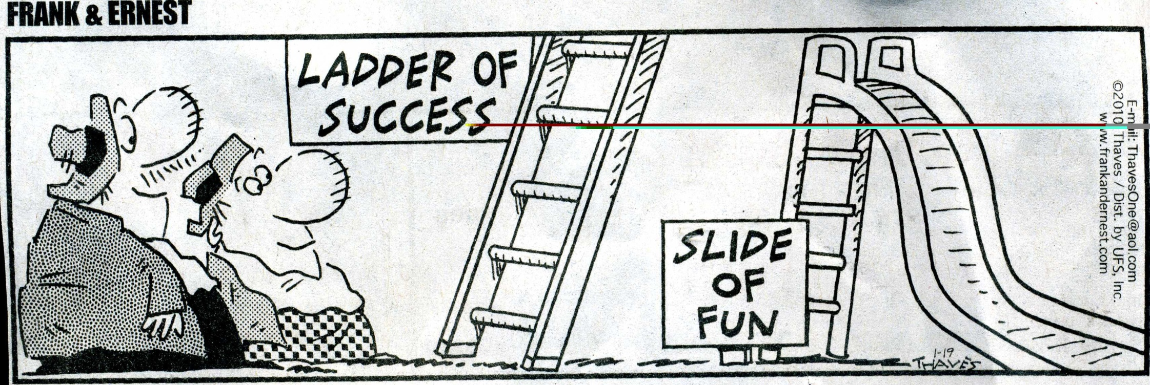

Slide 27
What does it mean to be proficient?

Slide 28
What is rigor for a first grader, a fourth grader, or an sixth grader? How does rigor look if the child is gifted?

Slide 29
What can you do to take students to higher levels of academic achievement?

Slide 30
Think about high achievers when decisions are made.

Slide 31
When decisions are being made, ask frequently:
How will this [decision] affect our brightest students?
How will this [decision] help other students begin to achieve at high levels?
Mind the (Other) Gap, (2010) p. 30

Slide 32
Remember the need for peers – idea-mates as well as age-mates.

Slide 33
Grouping for instructional purposes establishes communities of learners. It is the way to ensure that learners have peers with similar levels of readiness to learn. It provides opportunities to learn together with others who are equally good at math, reading, or any other content area.

Slide 34
Emphasize a growth mindset.

Slide 35
Mindset – Carol Dweck
Fixed – I have talent that I must demonstrate.
Growth – I have talent that I must work to develop.

Slide 36
Feedback to encourage a growth mindset involves praise for the process the student engages in—
hard work
focus
perseverance
use of errors to learn
improvement
trying many strategies.

Slide 37
“Success is about being your best self, not about being better than others; failure is an opportunity, not a condemnation; effort is the key to success.”
-Dweck, 2007, p. 44

Slide 38
What is important to celebrate at your school?

Slide 39
What do you celebrate?
In the free culture, you get what you celebrate. If we don’t celebrate these things, why are you going to get kids to put their time, their energy and their passion toward those things? So whether they’re inner-city kids with no resources or yuppie kids who have more than is reasonable, they’ll all bounce a ball for hours a day because it’s their way out. They are all going to be the next NBA star because it’s cool. -Dean Kamen

Slide 40
Celebrate what is most important for academic success.

Slide 41
Remember the purpose of school is for each child to be learning.

Slide 42
The least achievement gain is from our brightest students.

Slide 43
The surest way to make it hard for children is to make it easy for them. -Eleanor Roosevelt

Slide 44
If you don’t do hard work, you won’t feel confident. -Sylvia Rimm

Slide 45
The harder you work, the smarter you are. The smarter you are, the harder you work. -Sylvia Rimm

Slide 46
Gifted Student’s Bill of Rights
You have a right…
…to know about your giftedness
…to learn something new every day
…to be passionate about your talent area without apologies
…to have an identity beyond your talent area
…to feel good about your accomplishments
…to make mistakes
…to seek guidance in the development of your talent
…to have multiple peer groups and a variety of friends
…to choose which of your talent areas you wish to pursue
...not to be gifted at everything
- Del Siegle

Slide 47
What is your mission statement?
How does it relate to this morning’s discussion?

Slide 48
What do children who are gifted and talented know and what are they able to do if the mission of your school system is fulfilled ?

Slide 49
The goal of school is for each child to learn – to make continuous progress.

Slide 50
What about those children of high ability who are not recognized?

Slide 51
The Underrepresented Child in Gifted Education
Low socio-economic background
English Language Learner
Twice exceptional
Minority: African-American, Hispanic, and other non-whites (Except for Indian, Chinese, or Japanese)

Slide 52
…in 2006, Black students represented 17.13% of the public school population, but only 9.15% of those in gifted education – a 47% discrepancy. This percent is significant in and of itself, but takes on new meaning when translated into actual numbers. Specifically, these unidentified students equate to over 250,000 Black students who are not participating in gifted education. This is not a trivial number. Each one will be hard-pressed to become an achiever and to have his/her dreams fulfilled, because they are not placed in classes designed to meet their needs.
Ford & Troutman, 2010, p. 2

Slide 53
Young Scholars Program
Research-based practices to increase identification of and effectively nurture historically underrepresented, high-ability students

Slide 54
“Young Scholars are students who are not likely to be considered for gifted programs using current methods of identification and who, without that opportunity, are less likely to pursue advanced learning on their own.”

Slide 55
“Historically, these students have lacked access to gifted services, advocates for their high potential, and affirmation of their advanced abilities.”
Horn, 2014, p. 48

Slide 56
Role of Principals
The principals of Young Scholars schools are committed to increasing the number of low socioeconomic, minority learners participating in gifted programs at their schools, and they play a key role in the success of the model….These leaders are strong advocates for the students; they provide ongoing support to the teachers, and they ensure that year after year the Young Scholars are placed with teachers who know how to nurture and develop their gifted potential.
Horn, 2014, p. 47

Slide 57
Anytime that you do something to look at a child’s behavior or performance in a different way, then you’re going to extend your perception of what’s going on. So the more we look at children the more we’re going to find out about them. I think the more we work with Young Scholars, the more potential we’re going to see…. Since I’ve worked with Young Scholars, my expectations have been broader,; I have higher expectations for children who are able to perform better. Everyone has an idea of what giftedness is, but Young Scholars has broadened my perspective about who is brought into that category.
Young Scholars Principal (cited in Horn, 2014, pp. 55-56)

Slide 58
Grouping for Instructional Purposes

Slide 59
Types of grouping
Whole class
Cluster grouping
Grouping between classes for specific content
Within the class grouping
Cooperative groups

Slide 60
No matter the type of grouping used, if you don’t modify the instruction, nothing will change. It will not make a difference in achievement.

Slide 61
Cluster Grouping
The placement of several high-achieving, high-ability, or gifted students in a regular classroom with other students and with a teacher who has received training or who has a desire to differentiate curriculum and instruction for these “target” students.
-Gentry, 2013

Slide 62
Total School Cluster Grouping & Differentiation: A Comprehensive, Research-Based Plan for Raising Student Achievement and Improving Teacher Practices (2nd ed.), Marcia Gentry

Slide 63
Cluster grouping operates on the premise that gifted education practices will enhance the educational experiences within an entire school.

Slide 64
“Benefits are slight from programs that group children by ability but prescribe common curricular experiences for all ability groups.” -Kulik (1992)

Slide 65
When is cluster grouping planned?

Slide 66
Who puts students into clusters?

Slide 67
Which children are in the clusters?

Slide 68
Children are distributed across the classes but not heterogeneously. They are spread among the classes in clusters.

Slide 69
What do clusters look like?
Specifically planned to reduce the range of ability and achievement.

Slide 70
This allows the educator to target instruction more precisely.

Slide 71
Cluster grouping provides an organizational framework
Places students into classrooms on the basis of achievement
Flexibly groups and regroups students as needed for instruction (based on interest and needs)
Provides appropriately challenging learning experiences for all students

Slide 72
Research-based application of cluster grouping to…
Provide full-time services to high-achieving elementary students
Help all students improve their academic achievement and educational self-efficacy
Help teachers more effectively and efficiently meet the diverse need of their students
Weave gifted education and talent development “know-how” into the fabric of all educational practices in the school

Slide 73
The Twice-Exceptional (2e) Student

Slide 74
Gifted children with disabilities continue to be ignored, programs for them are lacking, and their problems are compounded by sometimes severe social problems and rock-bottom feelings of self-work and personal integrity…. It is indeed time to lift the mask.
Gary Davis, Syliva Rimm, & Del Siegle

Slide 75
National Twice-Exceptional Community of Practice defines 2e individuals this way:
Twice-exceptional individuals evidence exceptional ability and disability, which results in a unique set of circumstances. Their exceptional ability may dominate, hiding their disability; their disability may dominate, hiding their exceptional ability; each may mask the other so that neither is recognized or addressed.

Slide 76
2e students, who may perform below, at, or above grade level, require the following:
Specialized methods of identification that consider the possible interaction of the exceptionalities,
Enriched/advanced educational opportunities that develop the child’s interests, gifts, and talents while also meeting the child’s learning needs,
Simultaneous supports that ensure the child’s academic success and social-emotional well-being, such as accommodations, therapeutic interventions, and specialized instruction.
Working successfully with this unique population requires specialized academic training and ongoing professional development.
Baldwin, Baum, Pereles, & Hughes, 2015, p. 212-213

Slide 77
When cluster grouping, 2e students should be included in the cluster classroom.

Slide 78
What would this look like in your schools?

Slide 79
Gilmore Lane
 | 1st Grade Class A | 1st Grade Class B | 2nd Grade Class A | 2nd Grade Class B | 3rd Grade Class A | 3rd Grade Class B
Cluster | 8 |  | 6 |  | 6
Above Average |  | yes |  | yes |  | yes
Average | yes | yes | yes | yes | yes | yes
Low Average | yes |  | yes |  | yes
Low |  | yes |  | yes |  | yes
Special Education | Only those with high ability | yes | Only those with high ability | yes | Only those with high ability | yes

Slide 80
King Elementary
 | 1st Grade Class A | 1st Grade Class B | 1st Grade Class C | 2nd Grade Class A | 2nd Grade Class B | 2nd Grade Class C | 3rd Grade Class A | 3rd Grade Class B | 3rd Grade Class C
Cluster | 18 |  |  | 18 |  |  | 10
Above Average | yes | yes |  | yes | yes |  |  | yes
Average |  |  | yes |  |  | yes | yes |  | yes
Low Average |  | yes | yes |  | yes | yes | yes | yes | yes
Low |  | yes |  |  | yes |  |  | yes
Special Ed | Only those with high ability |  | yes | Only those with high ability |  | yes | Only those with high ability |  | yes

Slide 81
Shacklette Elementary
 | 1st Grade Class A | 1st Grade Class B | 1st Grade Class C | 2nd Grade Class A | 2nd Grade Class B | 2nd Grade Class C | 3rd Grade Class A | 3rd Grade Class B | 3rd Grade Class C
Cluster | 5 |  |  | 10 |  |  | 19
Above Average |  | yes | yes |  | yes | yes | yes | yes
Average | yes | yes | yes | yes | yes | yes |  |  | yes
Low Average | yes | yes |  | yes | yes |  |  | yes | yes
Low |  |  | yes |  |  | yes |  | yes
Special Ed | Only those with high ability | yes |  | Only those with high ability | yes |  | Only those with high ability |  | yes

Slide 82
Watson Lane
 | 1st Grade Class A | 1st Grade Class B | 1st Grade Class C | 2nd Grade Class A | 2nd Grade Class B | 2nd Grade Class C | 3rd Grade Class A | 3rd Grade Class B | 3rd Grade Class C
Cluster | 10 |  |  | 14 |  |  | 15
Above Average |  | yes | yes | yes | yes |  | yes | yes
Average | yes | yes | yes |  |  | yes |  |  | yes
Low Average | yes | yes |  |  | yes | yes |  | yes | yes
Low |  |  | yes |  | yes |  |  | yes
Special Education | Only those with high ability | yes |  | Only those with high ability |  | yes | Only those with high ability |  | yes

Slide 83
Zachary Taylor
 | 1st Grade Class A | 1st Grade Class B | 1st Grade Class C |  | 3rd Grade Class A | 3rd Grade Class B | 3rd Grade Class C
Cluster | 9 |  |  |  | 12
Above Average |  | yes | yes |  | yes | yes
Average | yes | yes | yes |  |  |  | yes
Low Average | yes | yes |  |  |  | yes | yes
Low |  |  | yes |  |  | yes
Special Education | High ability only | yes |  |  | High ability only |  | yes
 | 2nd Grade Class A | 2nd Grade Class B | 2nd Grade Class C | 2nd Grade Class D
Cluster | 18
Above Average | yes | yes
Average |  | yes | yes | yes
Low Average |  | yes | yes | yes
Low |  |  | yes | yes
Special Education | High ability only |  | yes | yes

Slide 84
Research-Based Benefits of cluster grouping
Gifted students regularly interact with intellectual peers and age-mates
Full-time services are provided for gifted students without additional costs
Curricular differentiation is more efficient and likely to occur when a group of high-achieving students is placed with a teacher who has expertise, training, and a desire to differentiate curriculum than when distributed among many teachers.

Slide 85
Benefits (continued)
Removing the highest achievers from most classrooms allows other achievers to emerge and gain recognition.
Student achievement increases when cluster grouping is used.
Over time, fewer students are identified as low achievers and more students are identified as high achievers.
Cluster grouping reduces the range of student achievement within all classrooms.

Slide 86
Who teaches the advanced cluster?
One prepared to differentiate for the cluster
One who wants to teach the cluster
One who will stay with the cluster three years

Slide 87
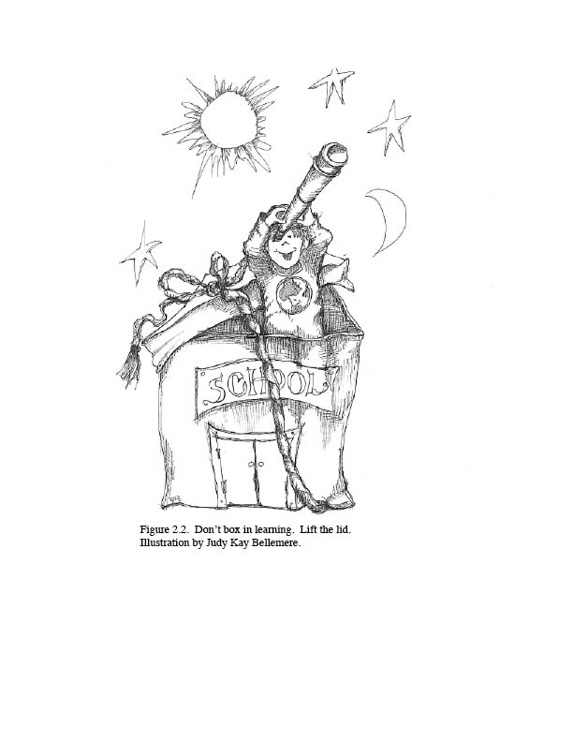

Slide 88
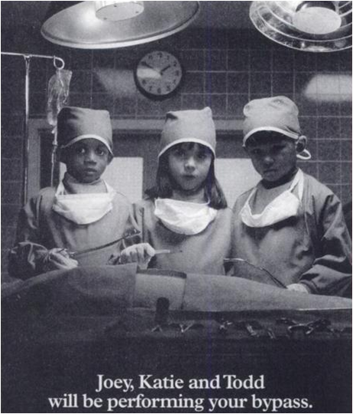

Slide 89
Other resource for cluster grouping
Winebrenner, S., & Brulles, D. (2008), The Cluster Grouping Handbook: How to Challenge Gifted Students and Improve Achievement for All, Minneapolis, MN: Free Spirit Press.

