Slide 1
Welcome!
Department of Public Health
Award & Hooding Ceremony
May 11, 2019

Slide 2
Undergraduate Awards

Slide 3

Kelly Coleman
Academic Excellence
in Health Information Management
Health Information Management
Baccalaureate Degree

Slide 4

Courtney Keown
Academic Excellence
in Health Sciences
Health Science
Bachelor of Science

Slide 5

Kristin Cordle
Academic Excellence
in Health Sciences
Health Sciences
Bachelor of Science

Slide 6
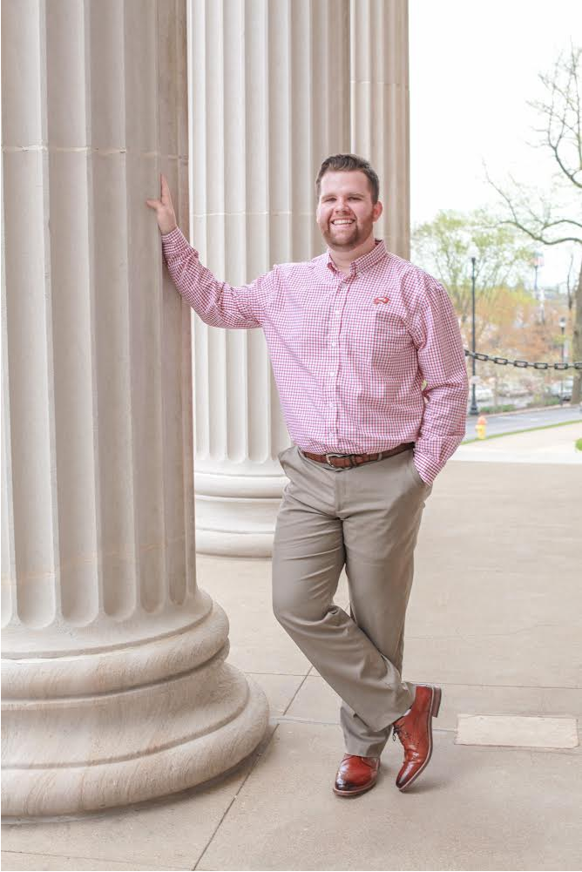
Isaiah Masters
HCA Leadership & Service
Health Care Administration
Bachelor of Science

Slide 7

Hannah Freeman
HCA Program Award for
Scholarship
Health Care Administration
Bachelor of Science

Slide 8

Erica S. Pitchford
Outstanding BSPH Student
Public Health
Bachelor of Science

Slide 9
Graduate Awards

Slide 10
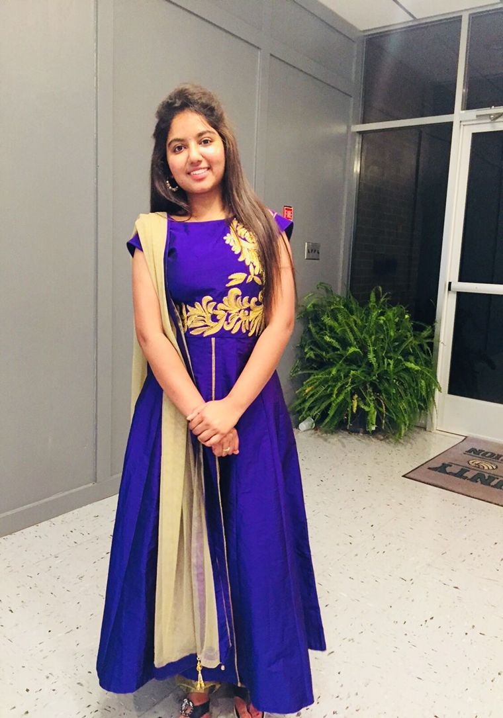
Sweety Seelam
EOHS Outstanding Graduate Student
Environment & Occupational Health Science
Master of Science

Slide 11
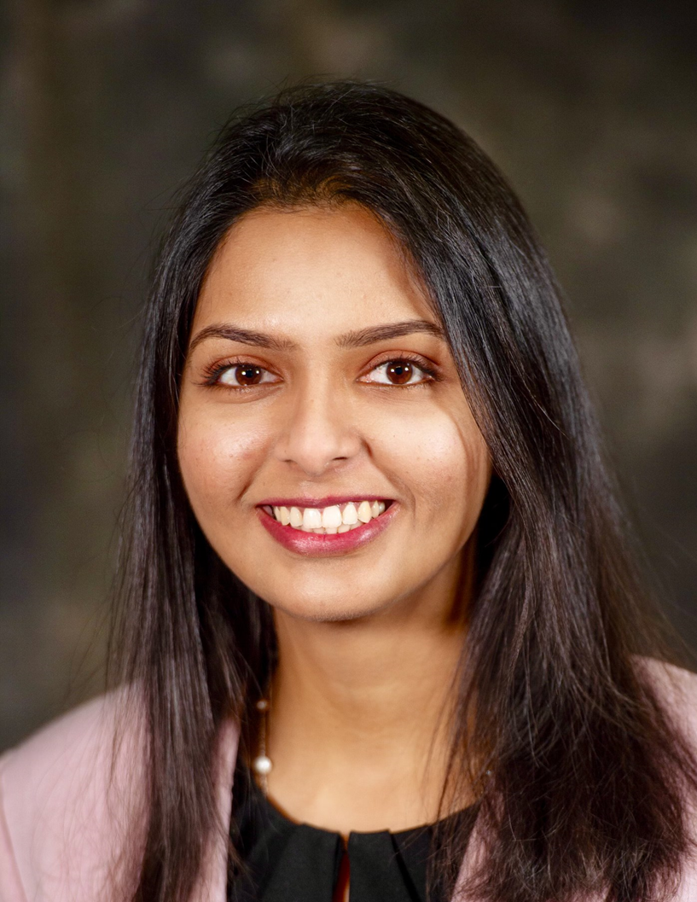
Rukhaiya Khatoon
MHA Leadership and Service
Master of Health Administration

Slide 12
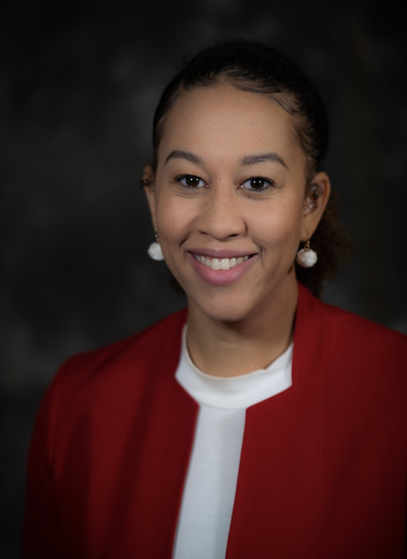
Israel Moore
Excellence in International Engagement
Master of Health Administration

Slide 13
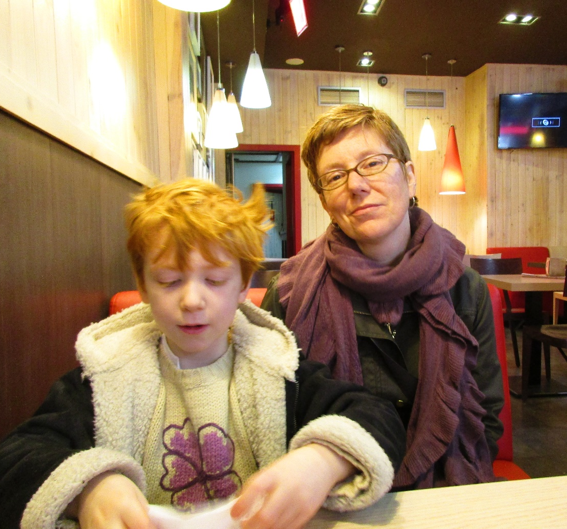
Susan Eagle
Academic Excellence
In Public Health
Master of Public Health

Slide 14
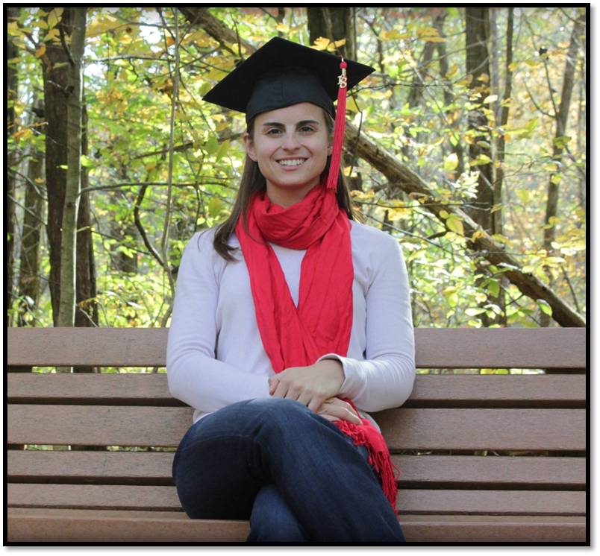
Catherine Malin
Academic Excellence
In Public Health
Master of Public Health

Slide 15
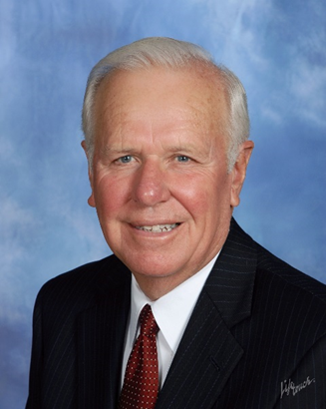
Dr. J. David Dunn
Professor Emeritus

Slide 16
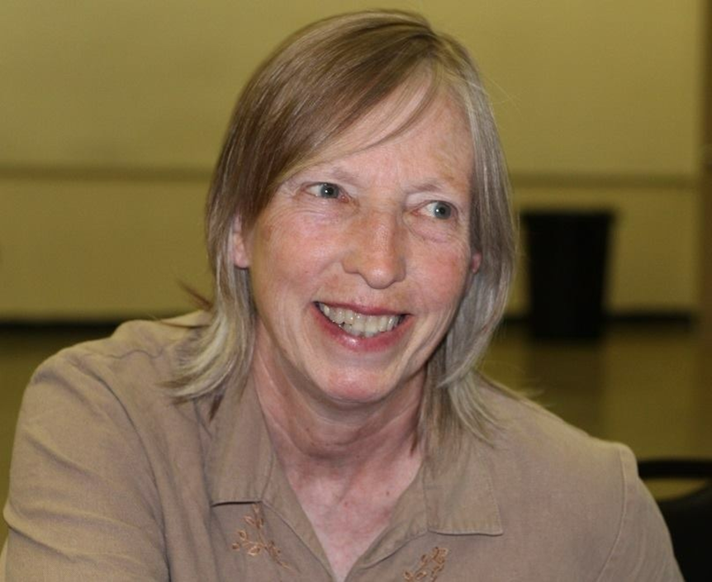
Ann Colbert
Dr. J. David Dunn
Public Health Impact Award
Master of Public Health

Slide 17
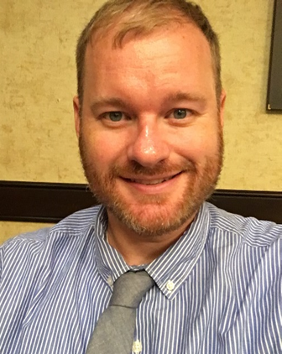
Jason Cummins
2019 Distinguished Alumnus
Master of Public Health
WKU Class of 2003

